Slide 1
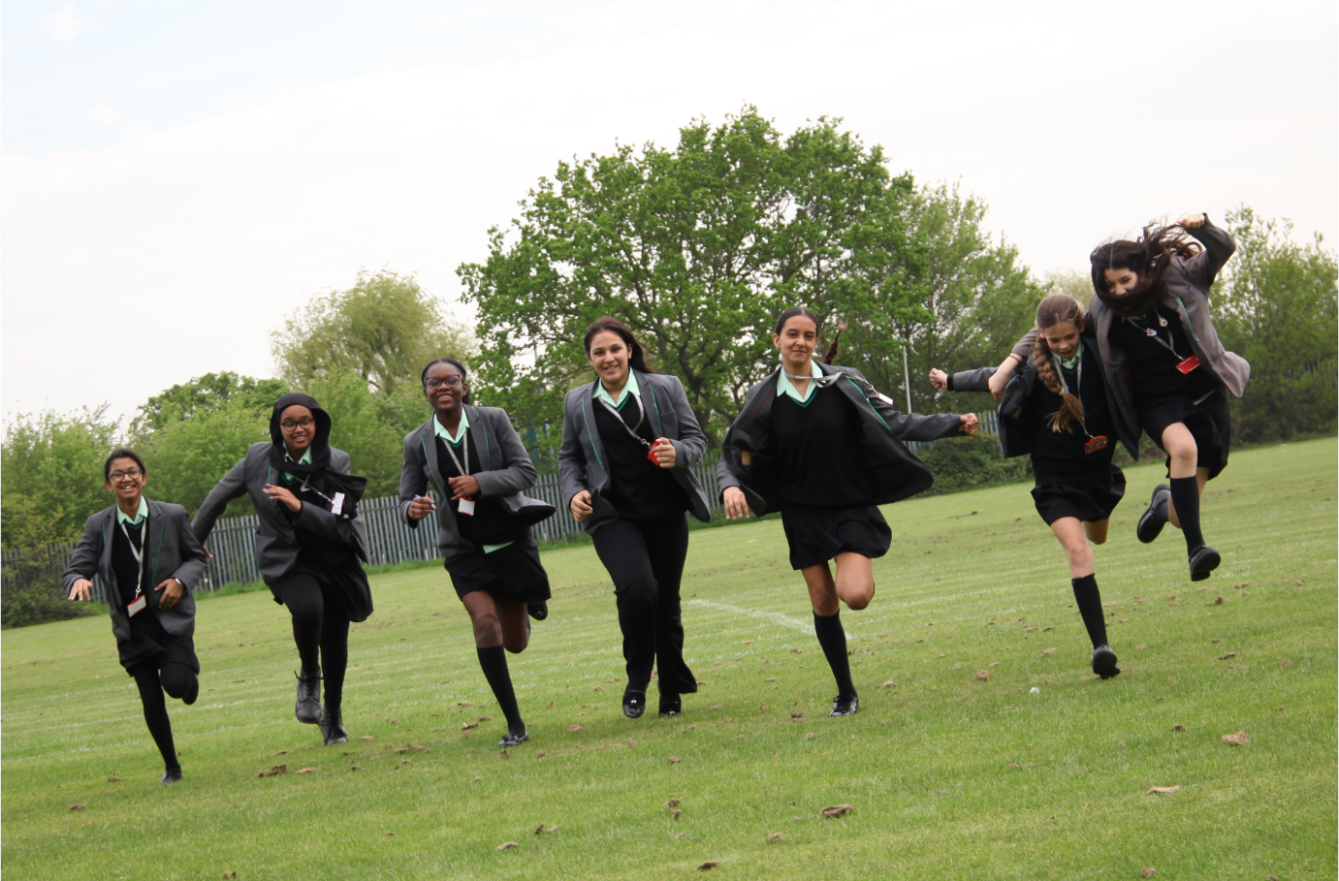
Please turn mobile phones
to silent. Thank you.
No fire drill is planned – if the
alarm sounds please follow
directions of staff outside
A very warm welcome to Swakeleys School for Girls
Ms Kelda Stevenson
Headteacher

Slide 2
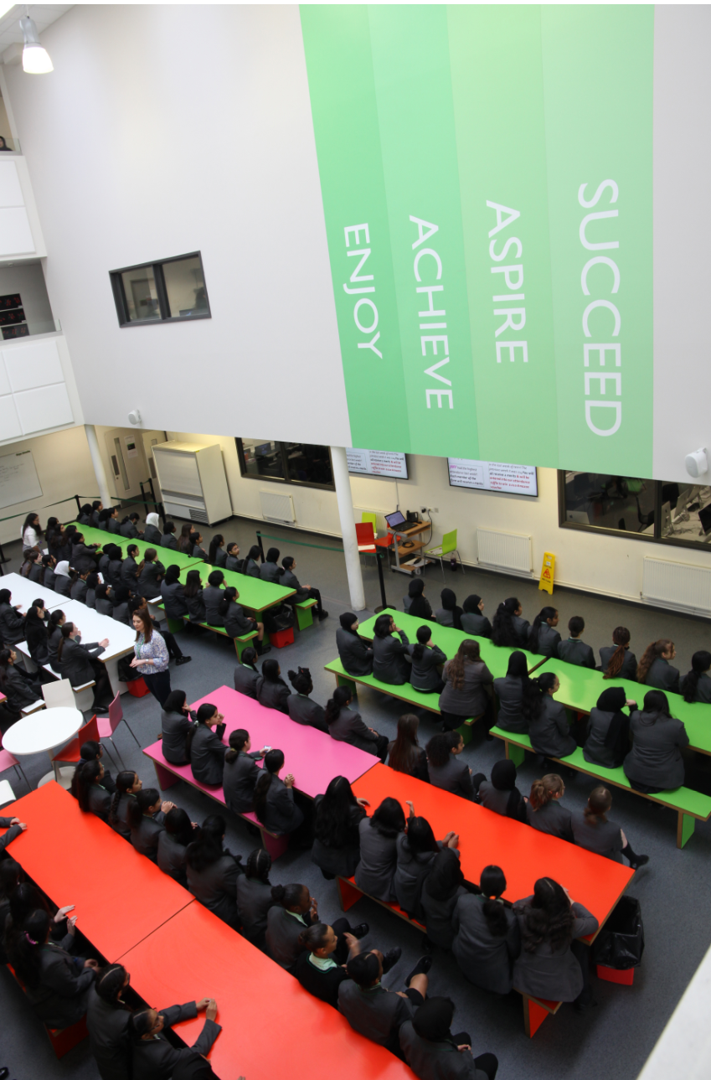

Slide 3
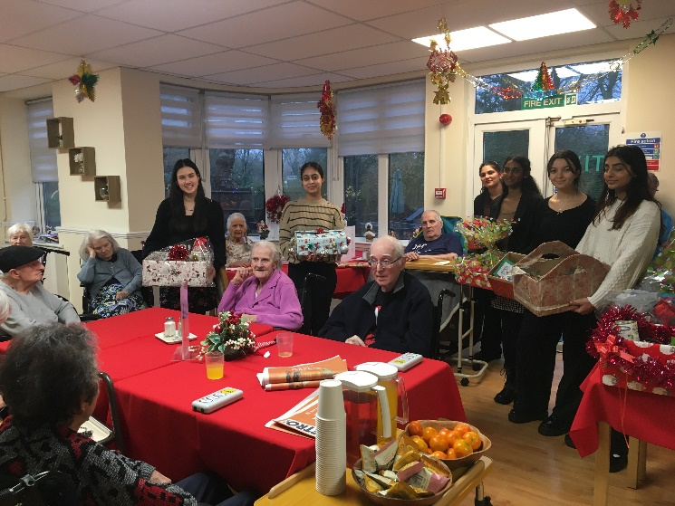
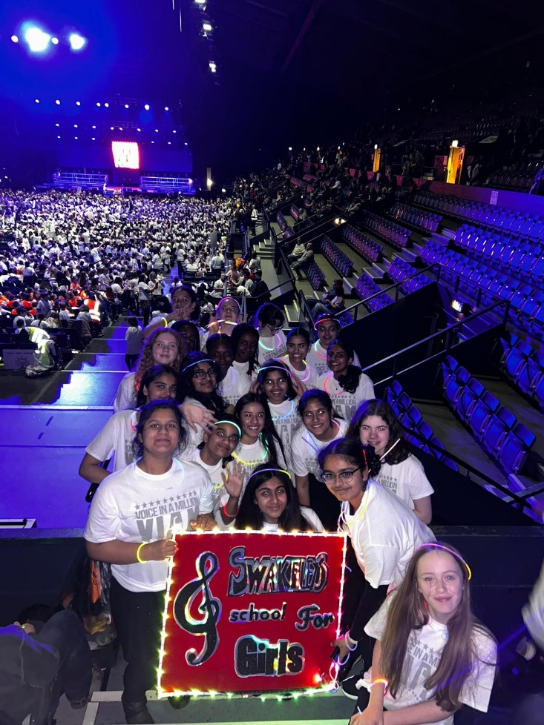
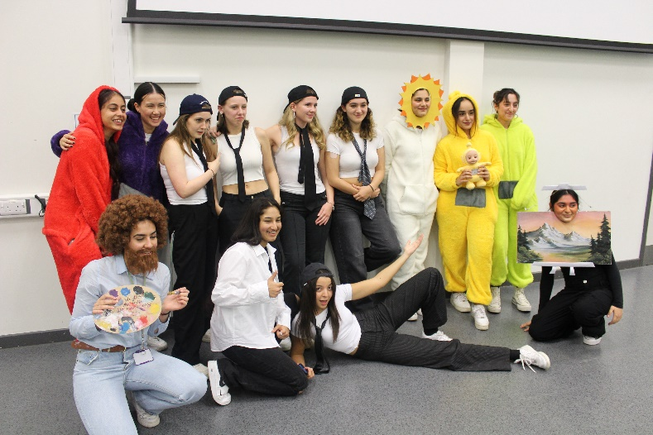
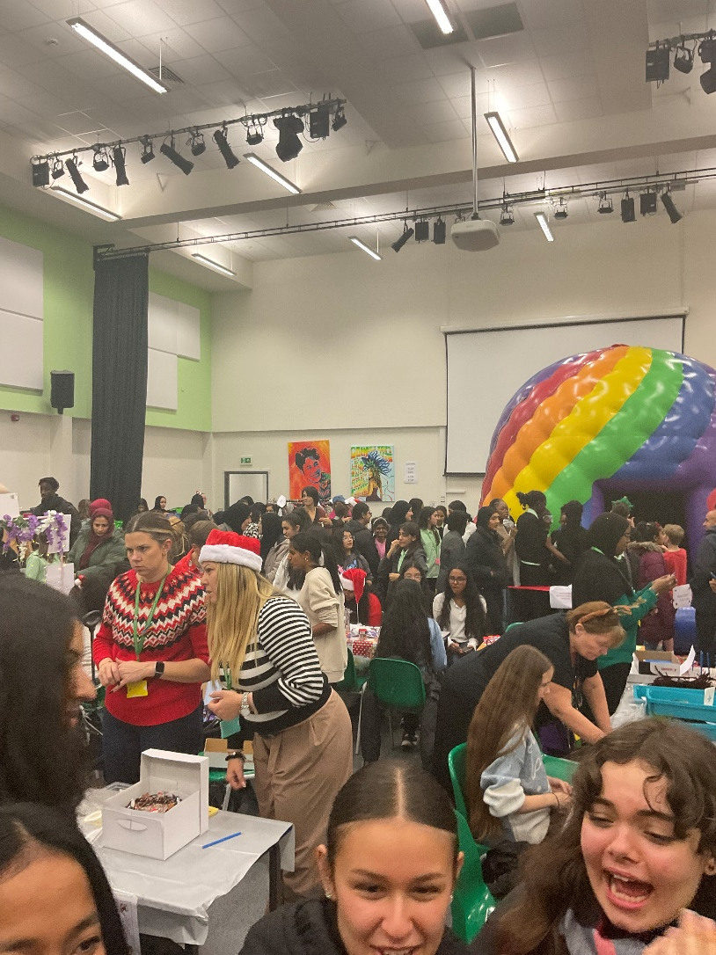
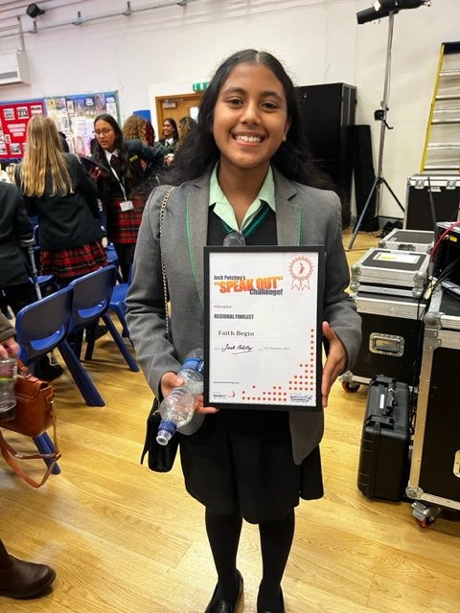
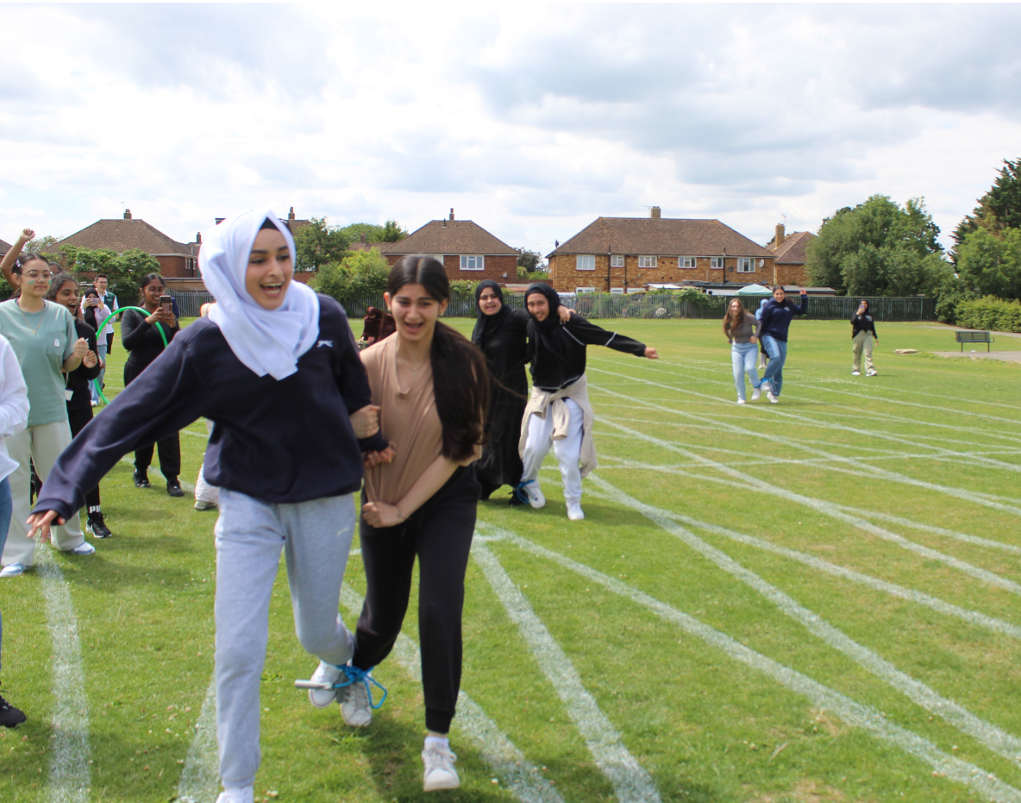
Enjoy

Slide 4
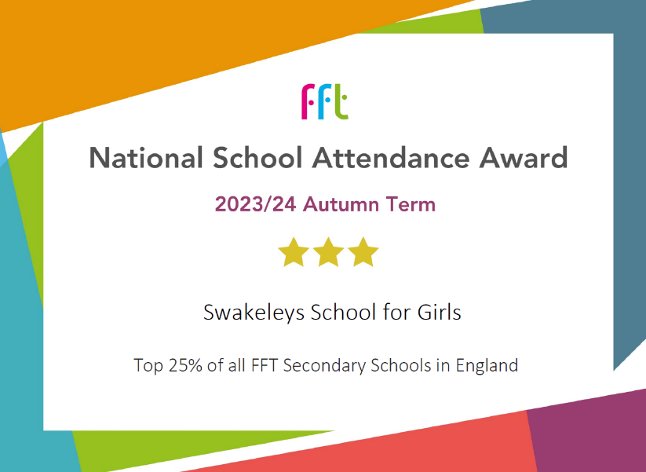
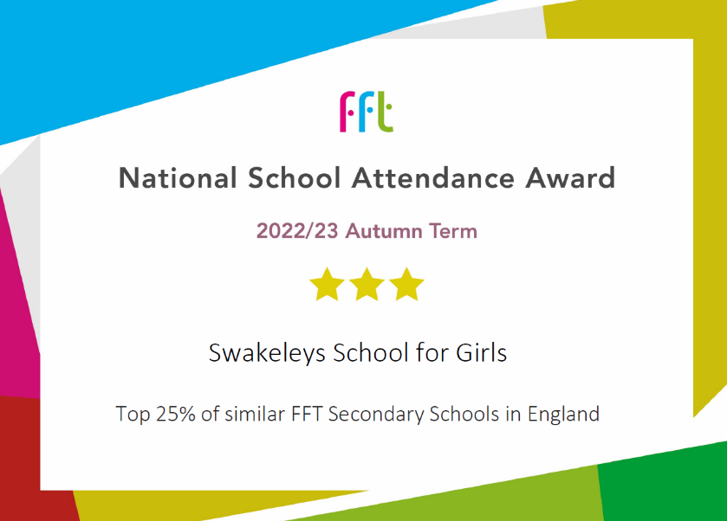
Attendance
Swakeleys student attendance is 2% above the national attendance

Slide 5
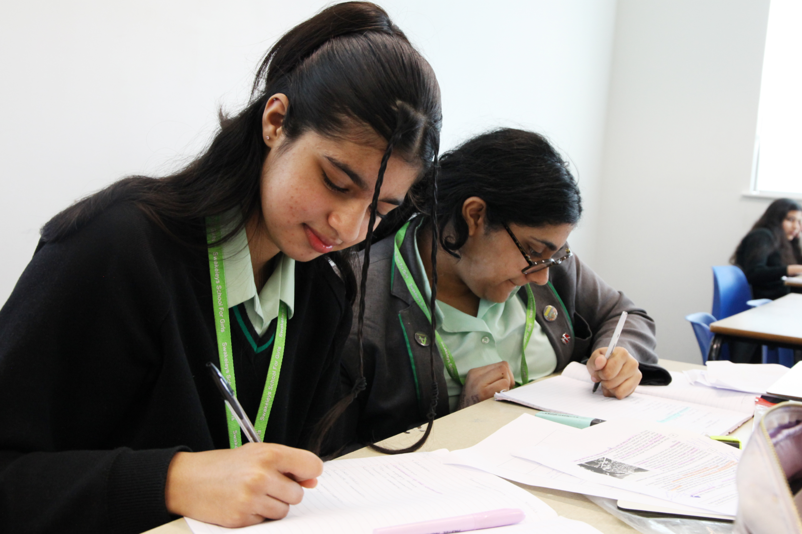
Achieve

Slide 6
Exam Success – GCSE
2024 headlines
80% achieved grade 4 and above with E&M
61% achieved grade 5 and above with E&M
 | Swakeleys 2024 | Hillingdon 2023
Attainment 8 | 53.2 | 46.0
9-5% E&M | 61% | 51%

Slide 7

Progress
Progress 8:
+0.62 in 2024
+0.49 in 2023
+0.93 in 2022
+0.84 in 2019

Slide 8
Exam Success – A level
2024 headlines
21% achieved A*/A
53% achieved A*-B
79% achieved A*-C
Notes:
At A level students achieved brilliantly with one fifth of grades being A*/A. Students worked incredibly hard and as a result were able to move on to follow their passion. Here are some destinations of our Year 13 leavers. I love seeing the variety of subjects and institutions that they have chosen and links to what I said earlier about being taught by subject specialists.

Slide 9
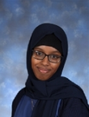
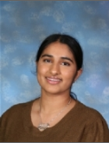
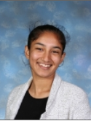
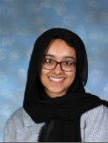
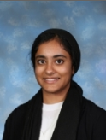
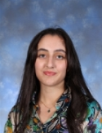
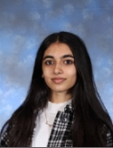
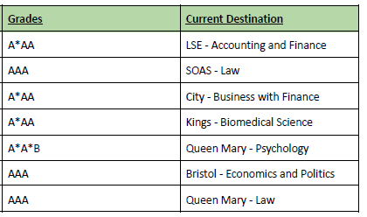
Year 13 successes and destinations

Slide 10


Awards 2023

Slide 11
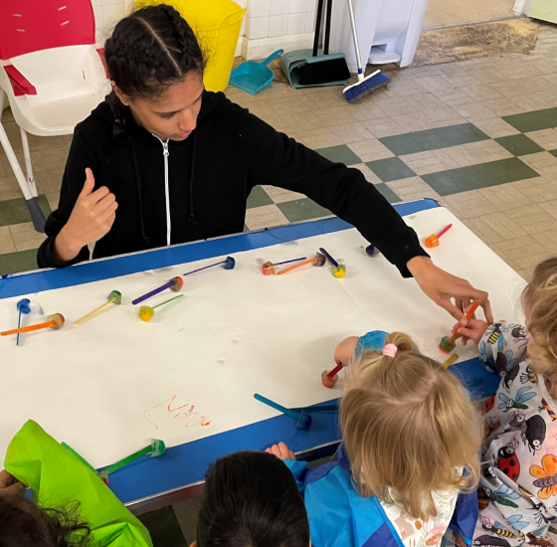
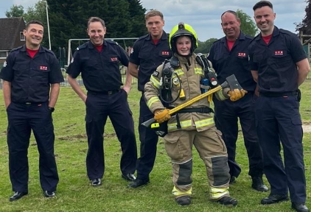
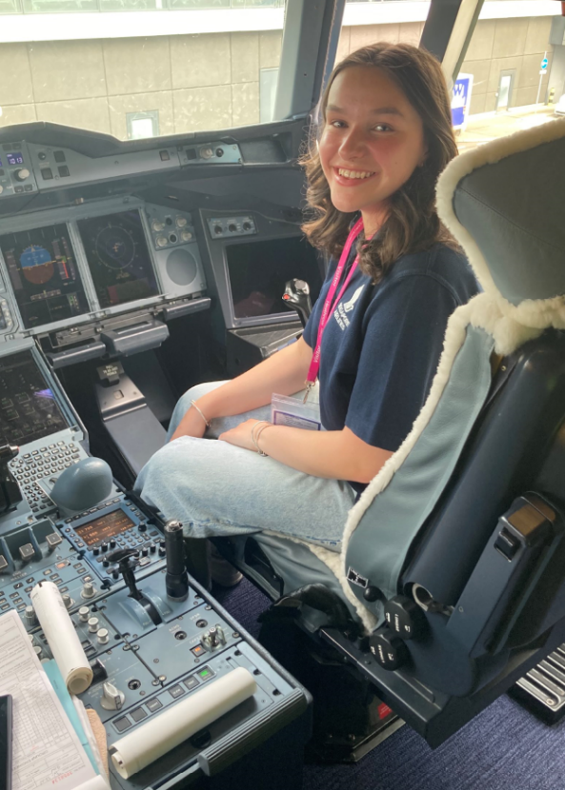
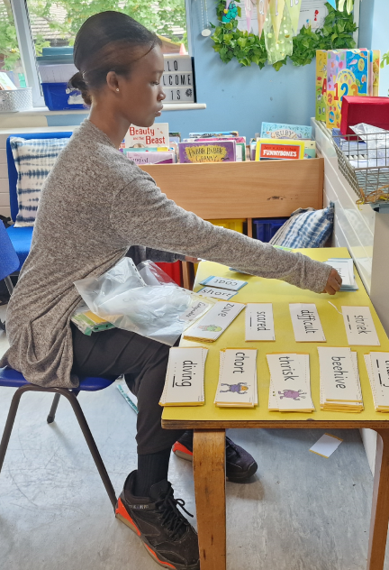
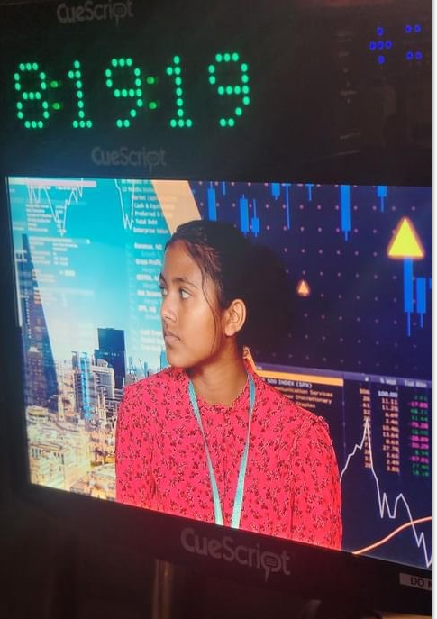
Aspire
Notes:
It is crucial to me that what we do at school prepares students for their future – whatever that may be. All the labour market research shows that students at school today will have a number of different careers
Confident when they leave school

Slide 12
Year 10 Work Shadowing
“She was very willing and has a wonderful character! We would like to offer her a job for the summer”
Sophie 10EB
“She has been excellent! Better than any student we have ever had before”
Simran 10AF
“Attentive, ambitious and brilliant!” Harmony 10MC
“What an excellent pupil, she is very natural and we have loved having her here on placement” Sadie 10JA
“Always eager to learn and do more!” Temilade 10FN
“A born teacher! She has gone above and beyond in her role here and is so positive with the pupils” Kayla 10MY
“I cannot fault Naina. She is an amazing student. She is really enjoying the placement and is very proactive”
Naina 10RP
“So professional and mature. It has been our pleasure to have Rohey working with us! Rohey 10MC
“We are so grateful for sending these two pupils to work at our library. They were wonderful and polite and always approached everything with a positive attitude. This experience has made is think very highly of the pupils at Swakeleys School”
Deborah & Ciele 10 DS
“She is personable, approachable and extremely enthusiastic. The students adore her!”
Rebekah 10AF
“I am so proud of her! She is well mannered, well organised and adaptable. I would like her to stay longer!”
Kajitha 10EB

Slide 13
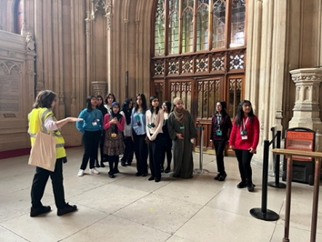
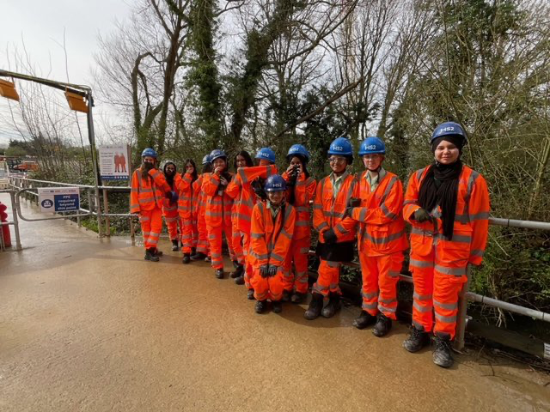
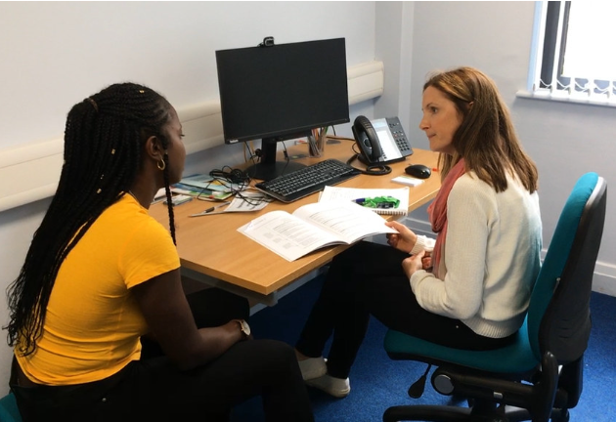
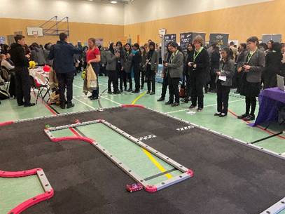

Slide 14
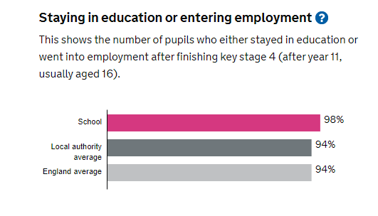

Slide 15
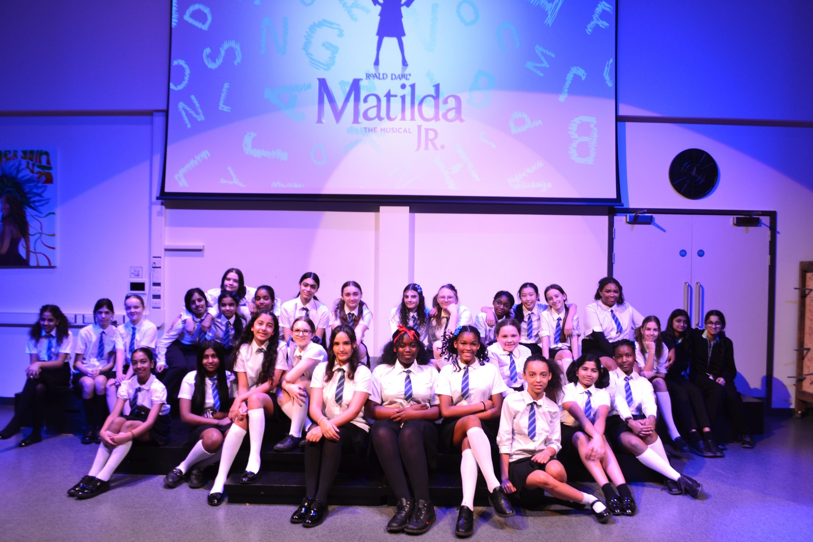
Succeed

Slide 16
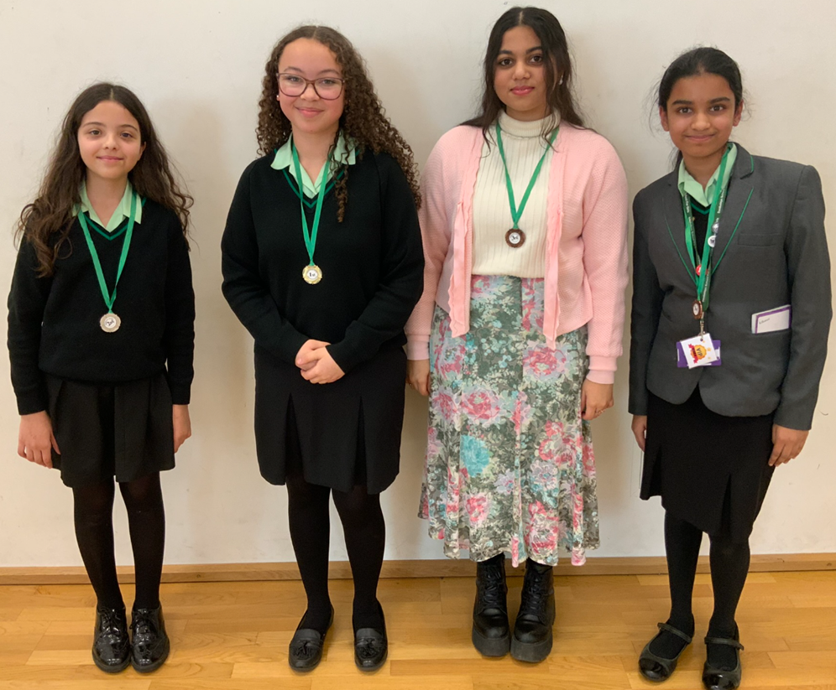

Slide 17
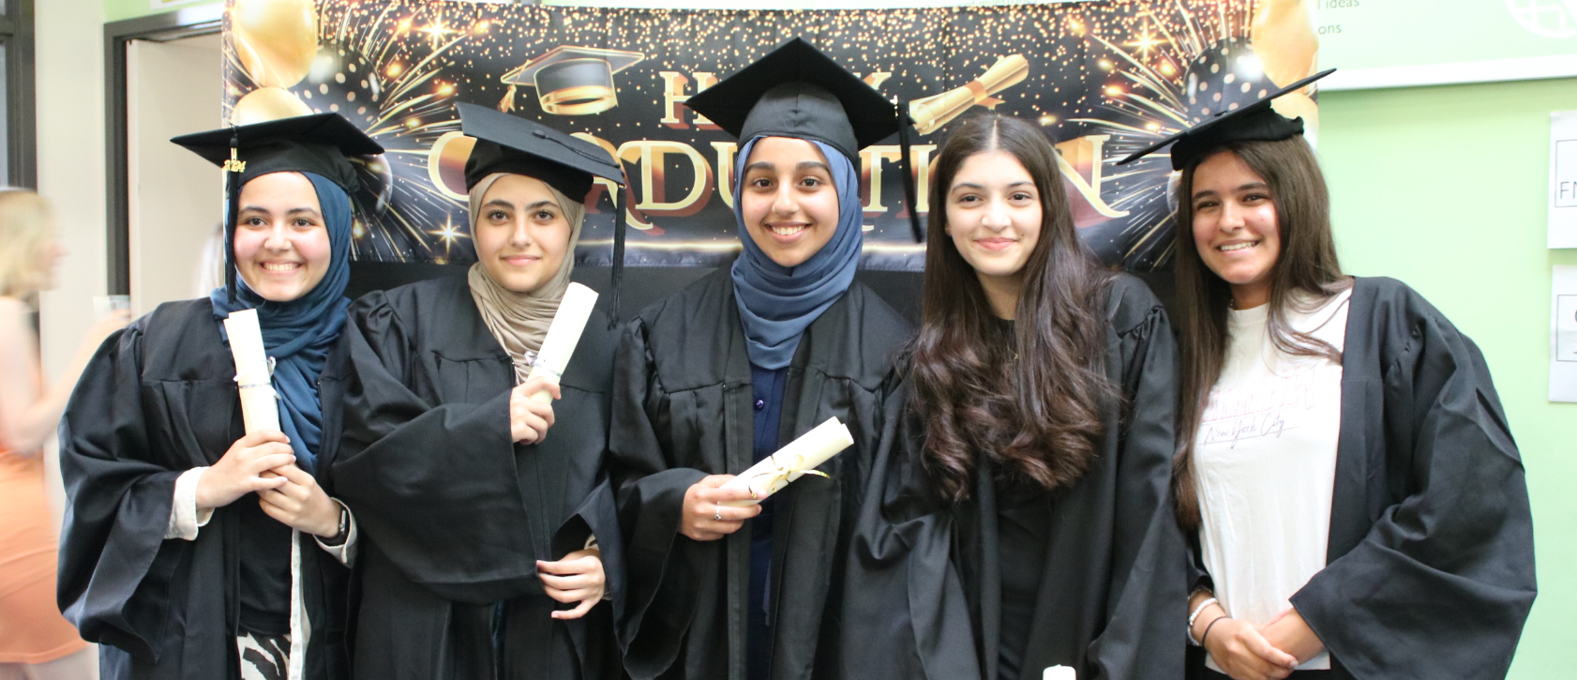
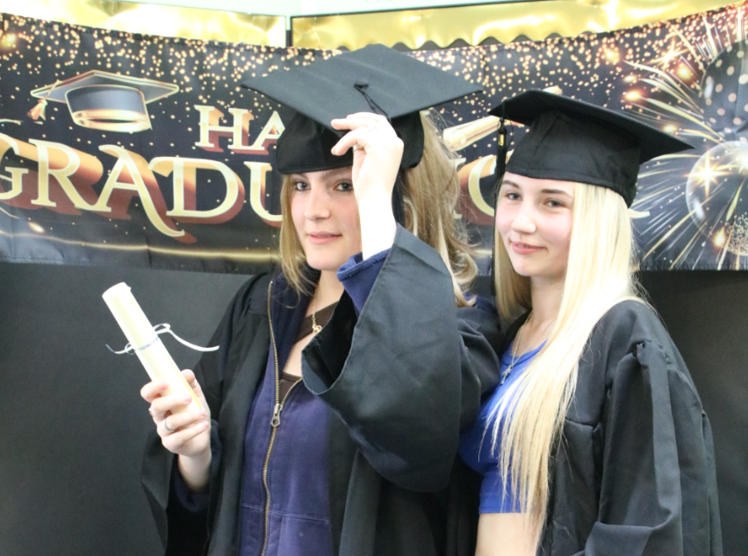
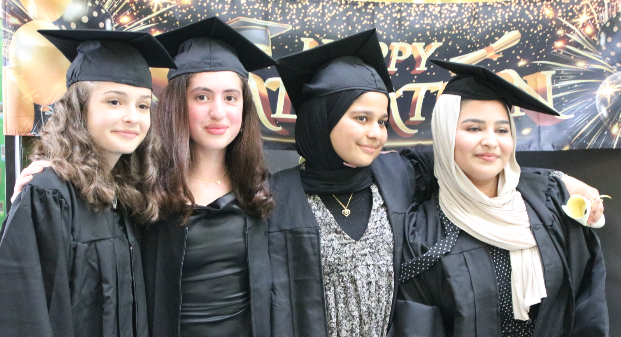


Slide 18
Research evidence of the benefits of a girls’ school*
“Girls-only education leads to higher academic achievement, greater diversity of subject choice, stronger self-confidence and resilience and enhanced career progression”
“Girls’ learning needs and preferences…tend to be different to boys”
“Girls often adapt their behaviour in the presence of boys – to their own disadvantage”
“In coeducational classrooms, boys tend to monopolise discussion…Teachers tend to adopt styles and use content that seek to maximise boys’ engagement and regulate their behaviour. Boys were given 8 times more attention by teachers”
*Kevin Stannard, MA PhD

Slide 19
“In addition to confirming academic advantages, the data shows that girls at single sex schools generally enjoy schools more, experience less bullying, have fewer disruptions in class, make friends more easily and feel more like they belong at the schools compared to girls from co-educational schools”
“female students from single-sex schools had significantly higher math self confidence, academic engagement and aspirations”
“Disadvantaged girls and those with SEND at single-sex schools reported higher wellbeing scores than their peers at co-ed schools.”
In 2018 over 75% of female secondary school pupils in the UK who attended co-ed schools claimed that they have been on the receiving end of sexist comments from other pupils. 50% of girls aged 13-16 have suffered harassment.”
“66% of girls give up on exercise by the age of 9”

Slide 20
What do our parents think?
93% of parents strongly agree/agree with the statement “my child is safe at this school”
91% of parents strongly agree/agree with the statement “my child does well at this school”
90% of parents strongly agree/agree with the statement “there is a good range of subjects offered at this school”
90% of parents strongly agree/agree with the statement“ my child can take part in clubs and activities at this school”

Slide 21
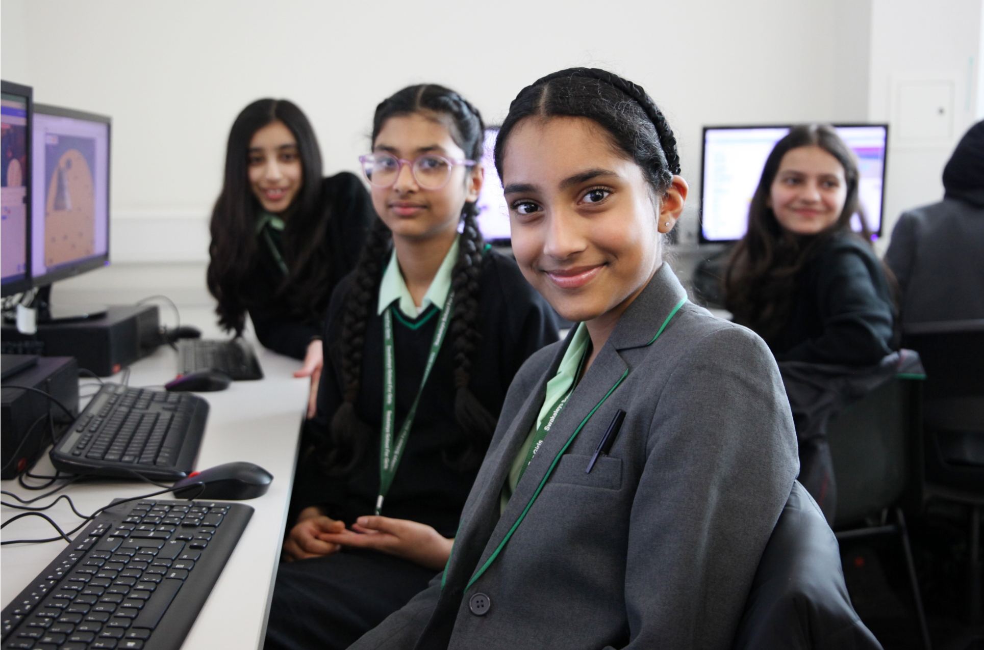

Slide 22
Aims of this evening
Session 1: Safeguarding: Mobile safety – how can parents keep their daughter safe online.
Session 2: Curriculum & Reports: Understanding reports at Swakeleys & how Curriculum Guides can support your daughter’s learning. How to use Google Classroom.
Session 3: Parents’ Evening: How to use School Cloud to book appointments.
Session 4: Homework & rewards: How to make the most of Epraise.

Slide 23


Year 7
Safe, Settled and Successful Evening
Session 1: Safeguarding:
Mobile safety – how can parents keep their daughter safe online.

Slide 24


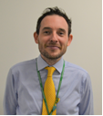

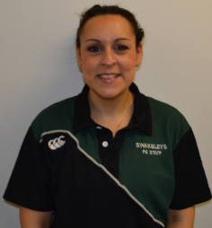
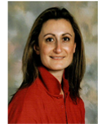
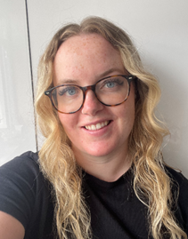
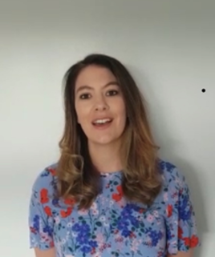
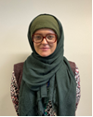
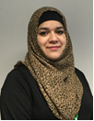

If you have any concerns or questions about the safeguarding of any young person while you are at Swakeleys School For Girls please speak immediately the Designated Safeguarding Lead or a trained Deputy.
New to the safeguarding team:
Miss Samantha Dickerson (SDI)
Family Liaison Officer
Miss Damini Chudasama (DCH)
Safeguarding Support Officer
Hillingdon MASH
strongerfamilieshub@hillingdon.co.uk
01895 556006
Mrs G Hare
Deputy Head/
Designated Safeguarding Lead
Mr L Hepner
Acting Deputy Head/ Deputy Designated Safeguarding Lead
Mrs J Cherry
Lead
Practitioner/
6th Form Pastoral Lead
Mrs L Finnerty
YLC
Ms S Mejloumian
YLC
Ms K Currell
YLC
Miss H Allan
YLC
Mrs R Khan
YLC
Mrs A Hussain
Pastoral Team
Ms S Hodges
Pastoral Team
Mr T Gray
YLC

Slide 25






Official Age Ratings
Whatsapp Snapchat
16+ 13+
Tik Tok YouTube
13+ 13+
Instagram Discord
13+ 13+
Notes:
Ask parents if they know the age ratings and then show them
What are the official age ratings for the following apps-have 30 seconds to think!
They are age rated for a reason-content, contact, conduct,
For KS3 Only: Much time is taken up with dealing with issues that arise from online behaviour. I would ask that you be aware that pupils in year 7/8 are too young to be accessing the above. Often in conversations with parents, especially around whats app, we are told they only have the app to contact famil/close friends etc. The fact is, they shouldn’t have it at all. This will inform how we deal with many online issues.

Slide 26
How to keep your child safe online
Research shows that pre-teens like to watch videos, play video games and use messaging apps.
It can be overwhelming knowing where to start when it comes to keeping your children safe online.
Internetmatters.org – a very helpful website with information to help parents/carers know how to keep their child safe online.
They have created their ABC online safety checklist…

Slide 27
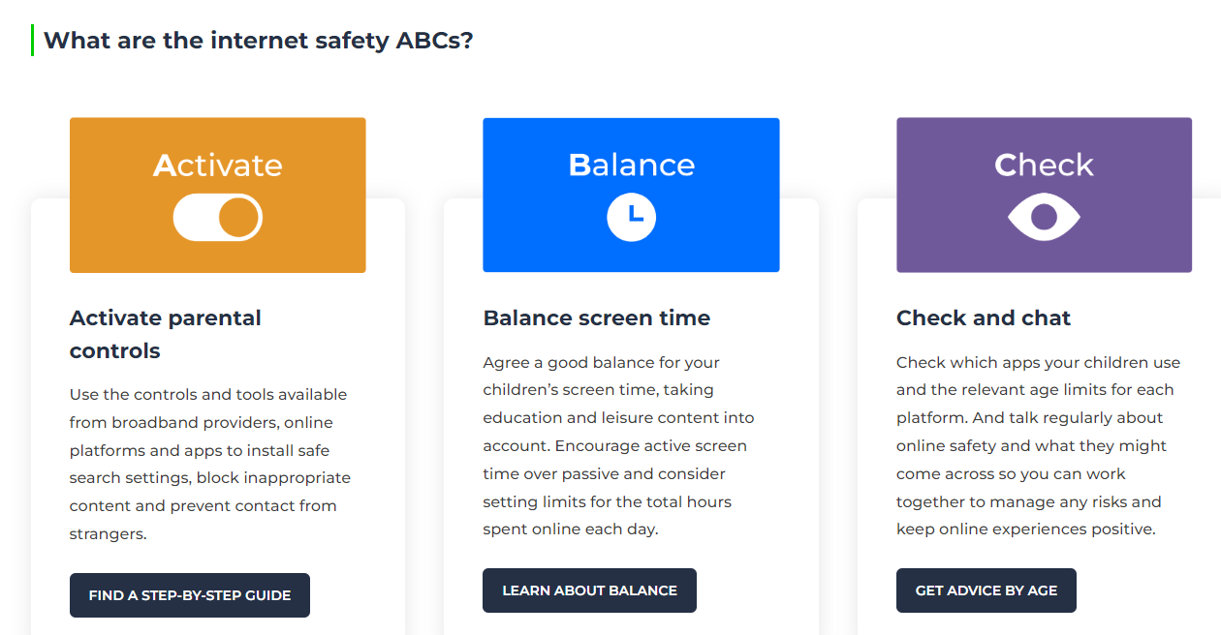

Slide 28
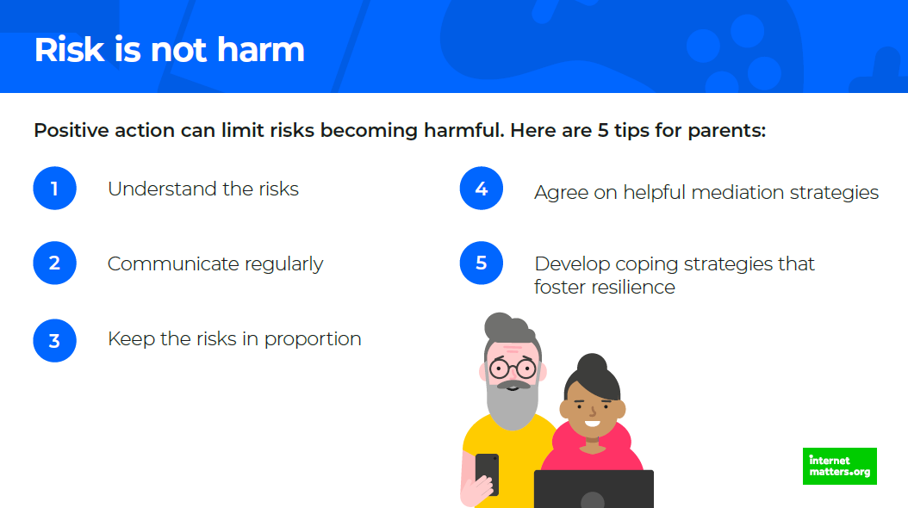
Notes:
Risk is not harm-and positive action can limit risk and prevent har. Go through the 5 tips for parents.

Slide 29
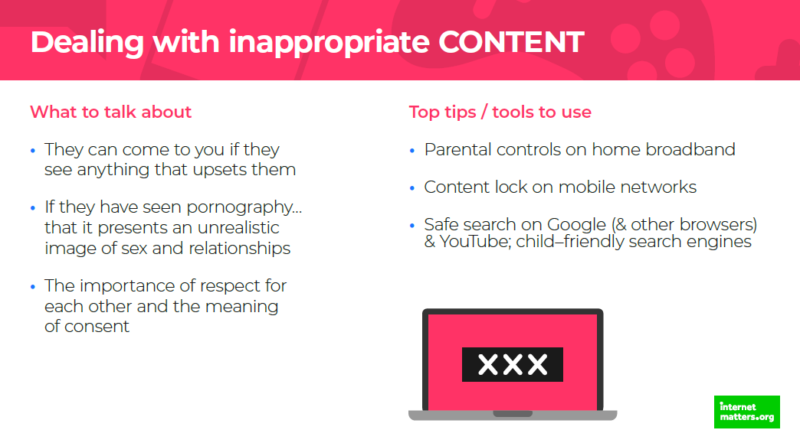
Notes:
Go through this slide reading out each section

Slide 30
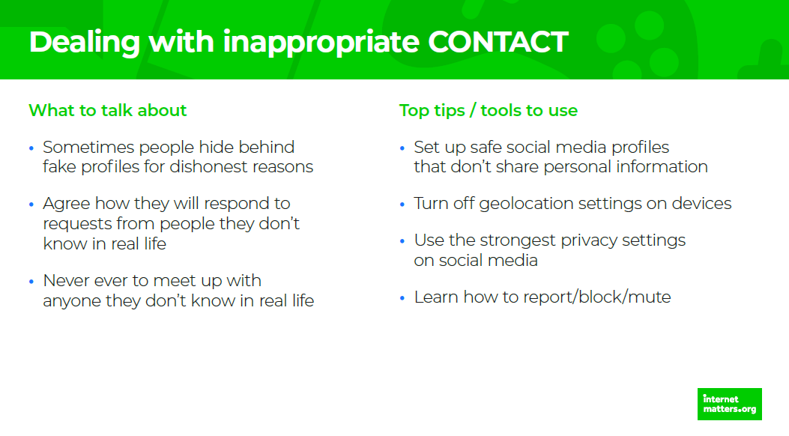
Notes:
Go through this slide reading it out.

Slide 31
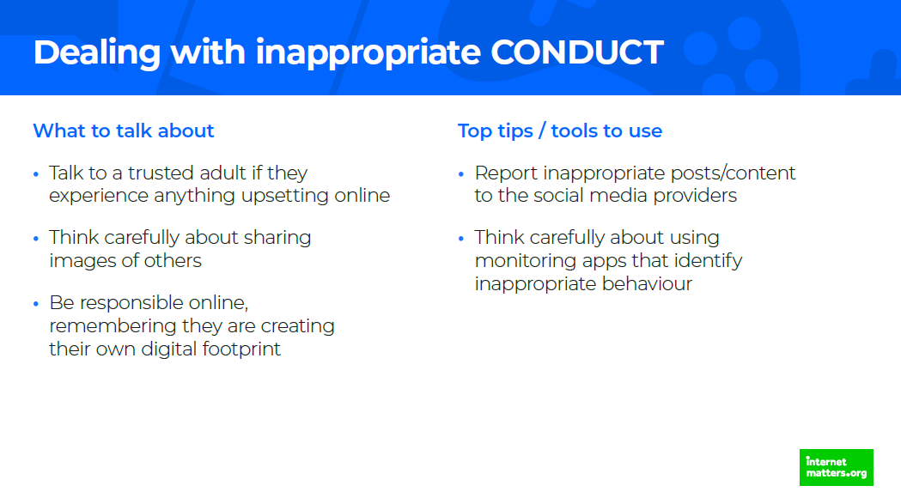
Notes:
Go through this slide reading it out

Slide 32
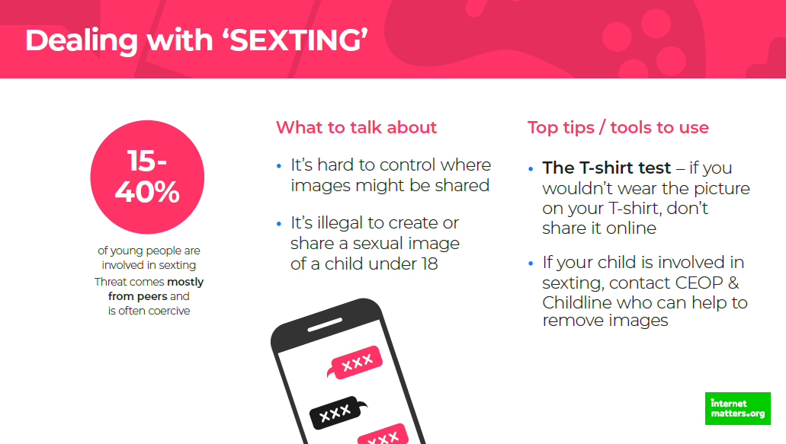
Notes:
Parents may need to deal with the issue of secting.
Go through the slide reading it out.

Slide 33
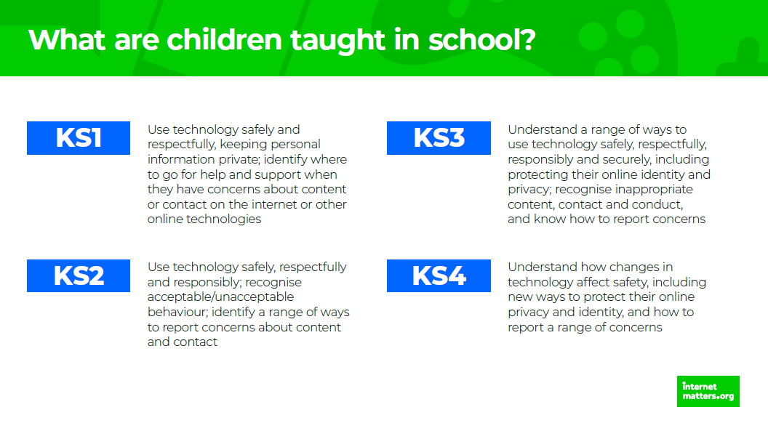
Notes:
Explain what pupils are taught in KS3 and 4 from the slide.

Slide 34
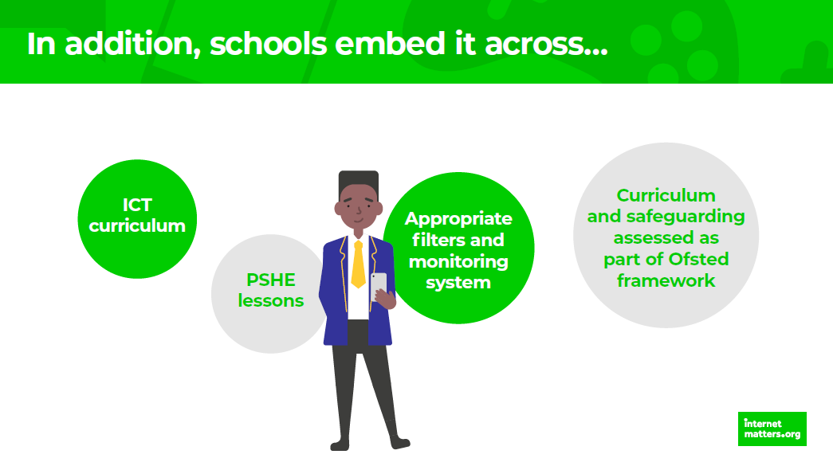
Notes:
Read out the slide

Slide 35

Notes:
Read out this slide

Slide 36
Things you might hear from us…..
We have offered your child strong words of advice to…
We will be issuing the following sanction…..
We advised your child not to share passwords/log ins
We advise you to limit your child’s screen time
We advise your child to close the account/delete the app/change their number
We are signposting you to…
We will report the matter to the police/make a referral to
We can advise you how to report this crime to the police…
Even though this happened online it has impacted on behaviour within the school/affected the reputation of the school so will fall under our behaviour policy and the action we are taking is….
This issue is a safeguarding concern and our action will be…
Notes:
Explain that there are policies about how we deal with online issues. When issues take place in school, or affect the school day, we will get involved. We may signpost you to the police if the matter is not covered under our behaviour policy.
Go through the slide which lists ways in which the school may respond to a report about social media issues
As parents you have the biggest impact on your child’s social media use and control of their accounts and access.

Slide 37
Things that you can do to keep your child safe online….
Give a time limit for how long they can be on their phone each day after school
Keep phones out of bedrooms at night – use an alarm clock for an alarm
Don’t allow them to use apps that they are legally too young to use
Switch off location sharing
Check the audience and tagging settings on apps
Regularly have conversations with your child about their online use & monitor their online use

Slide 38
Explore the link to the CEOP advice page for parents:
https://www.ceopeducation.co.uk/parents/
https://www.internetmatters.org/
Great advice for parents and carers

Slide 39


Slide 40


Slide 41
Mental Health services available
Place2Be and Place2Talk
Place2Be provides emotional and therapeutic services in primary and secondary schools, building young people's resilience through talking, creative work and play.
Place2Talk is here at break or lunchtime to support young people to think about any worries they might have.
How: Email place2be@swakeleys.org.uk
What: Book a 15 minute appointment with Ella
When: Break or lunchtime (Monday to Thursday)
For: Individual or small group session (up to 3 people)
Confidential unless there is a safeguarding concern

Slide 42

Mental Health services available
We also have a Pastoral Support Team.
Mentoring Service
Family Support Worker
Safeguarding Officer
shout : text support service
24/7 crisis text line
Text P2B to 85258
www.giveusashout.org

Slide 43
Year 7
Safe, Settled and Successful Evening
Session 2: Curriculum & Reports: Understanding reports at Swakeleys & how Curriculum Guides can support your daughter’s learning. How to use Google Classroom.

Slide 44

Assessment across Key Stage 3
Four Stages of Learning:
Mastery
Secure
Developing
Foundation
Many pupils will start out at the foundation stage of learning – please do not worry!

Slide 45
What do the Stages of Learning mean?
Mastery (High level learner)
Reached the Key Stage 3 requirements of the subject in many, if not all of the Progress Areas
Can extend and apply ideas and has a high level of subject thinking and reasoning
Secure (proficient leaner)
Good all-round basis in the subject
Link and relate ideas and concepts, strategies for thinking and reasoning
Developing (more competent learner)
Grasped many of the basic ideas and concepts of the subject
Link different skills and concepts together
Foundation (beginning learner)
Starting to grasp some of the basic content of the subject
Can recall and reproduce basic content and single ideas

Slide 46

Attendance % & the number of times your daughter has been late to school for the year so far.
Here, you can see how many achievement points and behaviour points your daughter has for the year so far.

Slide 47
Key dates for Year 7 Progress Checks
You will receive two Progress Check reports for the year:
Progress Check 1: 22nd January
Progress Check 2: 25th June
Parents Evening: Tuesday 18th March 3-6.30pm
The second progress check in June will also include the Year 7 exam grade (levels foundation-mastery) following the Year 7 Internal Exam period that runs from Monday 12th May – Friday 23rd May.
Year 7 will have a levelled assessment in each of their subjects during this time.

Slide 48
Curriculum Guides
Year 7 students study 16 subjects, all of which they continue until the end of Year 8. Curriculum Guides for each subject provides families and students with guidance on each of these subjects.
It outlines what Year 7 students will be taught, the type of assessment that pupils will experience during Year 7 and any resources that they will need.

Slide 49

How to find these on the school website
Hover the mouse over Curriculum

Slide 50

Click here

Slide 51


Slide 52

You can choose to view the curriculum guide by terms: This will give a summary of each subject for each half term

Slide 53

You can also download the curriculum guide that gives you each subject’s summary for every term.

Slide 54

Google Classroom – how can it support your daughter
Login Details:
Your daughter uses her Google Classroom login to access GC

Slide 55
Google Classroom
Your daughter should have joined a GC for every subject and Year 7 Pastoral Miss Allan.
Here lesson resources/information/updates will be given.
Students can also comment for example on an assignment if they need help and the teacher will reply as soon as possible.

Slide 56
Year 7
Safe, Settled and Successful Evening
Session 3: Parents’ Evening:
How to use School Cloud to book appointments.

Slide 57
What is School Cloud?
School Cloud is the virtual platform that Swakeleys use to carry out online face-face parent/teacher meetings.
Parents & staff were consulted about parents’ evenings and a high majority preferred online meetings.
Year 7 Parents’ evening is Tuesday 18th March 3-6.30pm
You will be sent instructions and given at least 10 days to book appointments with your daughter’s teachers.

Slide 58
Parents’ Evening
Every teacher has 30 slots for appointments, this means that if a teacher teaches multiple year 7 classes, not every parent will be able to have an appointment.
You will have 5 minutes to discuss your daughters progress, what she is doing well and areas for development.
At the end of the 5 minutes, the appointment will automatically end – this is part of the School Cloud system.

Slide 59

School Cloud
You will need to enter the exact same details that you entered on the Google form completed during the transition process.
If you are not certain about the details you have given, please contact the school office.

Slide 60
Year 7
Safe, Settled and Successful Evening
Session 4: Homework & rewards:
How to make the most of Epraise.

Slide 61

Epraise
Epraise is an intuitive platform that informs you of your child’s achievements, homework and timetable information.
The platform is available in both desktop and App formats

Slide 62
How does Epraise support your daughter?
Epraise can support your daughter in keeping organised:
  View her timetable
  View what homework has been set, when it is due and then homework can be marked off when the work has been completed
  View attendance % on Epraise
  View the amount of merits received and from which subjects
For the Autumn term, year 7 will only receive homework from English, maths & science.
From January, she will receive homework for every subject on a weekly or fortnightly basis. A notification will be sent as a reminder in January.

Slide 63

What can your daughter see when she logs in to Epraise?
When your daughter logs in to her account, she can click on ‘Me’ and it will show her homework.

Slide 64

Epraise & Homework
Key to show when homework is due, completed or overdue.

Slide 65

From the previous slides view, by clicking on ‘To do’, it will show the homework instructions for each piece of homework set.

Slide 66
How can Parents use Epraise to support your child?
Epraise is an excellent way of supporting your child with:
  Homework
  Attendance
  Rewards
You can download the Epraise app to your phones, this way you have access to seeing what homework your daughter has and can see the instructions in case they need your help.
Monitor attendance, we expect a minimum of 96% attendance to ensure your daughter makes progress academically & socially.
Monitor & praise the merits your daughter is receiving in school

Slide 67
For Parents: Registering for Epraise

Slide 68

Registering on the App

Slide 69

What can I view?
Notes:
Talk parents through some of the key aspects of the app. 1. The planner. This gives parents a clear understanding of the homework that has been set, deadlines and any attachments.
2. (see main rectangular image – This shows the amount of achievement points, the breakdown of points, the milestones tha tthey have achieved and any points they have spent in our Epraise shop.
3. Image bottom right gives the pupil timetable to support with organisation.

Slide 70

Points mean prizes! Coming soon!
Notes:
Pupils will be able to exchange their achievement points for prizes. Explain that achievement points can be traded for prizes. The Epraise shop will be launched after half term.

Slide 71
For further information click the below link:
https://community.epraise.veracross.com/s/article/Epraise-Parents-Registering
If you have any queries regarding your email address submitted to the school, please contact office@swakeleys.org.uk or talk to a member of staff on the form tutor 1:1 day on Friday 18th October

Slide 72
Key Dates for Year 7 Autumn Term
Thursday 3rd October: School Photographs.
Wednesday 9th October: INSET Day (no school for students)
Thursday 10th October: Form Councillors & Sub-Committee Representatives to have been elected
Monday 14th October: Year 7 Senator Nominees
Friday 18th October: Form Tutor We Listen Day Year 7
Half Term: Thursday 24th October – Friday 1st November
Friday 15th November: Year 7 Senator Elections.
Thursday 21st & Friday 22nd November: INSET Days
Wednesday18th December: Year 7 Pantomime
Friday 20th December: Christmas holidays, return to school Monday 6th January

Slide 73

Thank you
Please use the QR code to now complete the short questionnaire regarding your daughter’s start to secondary school:

