Slide 1
Welcome back into Swakeleys
Please switch mobile phones to silent. The muster point for a fire is the tennis courts – follow staff instructions

Slide 2
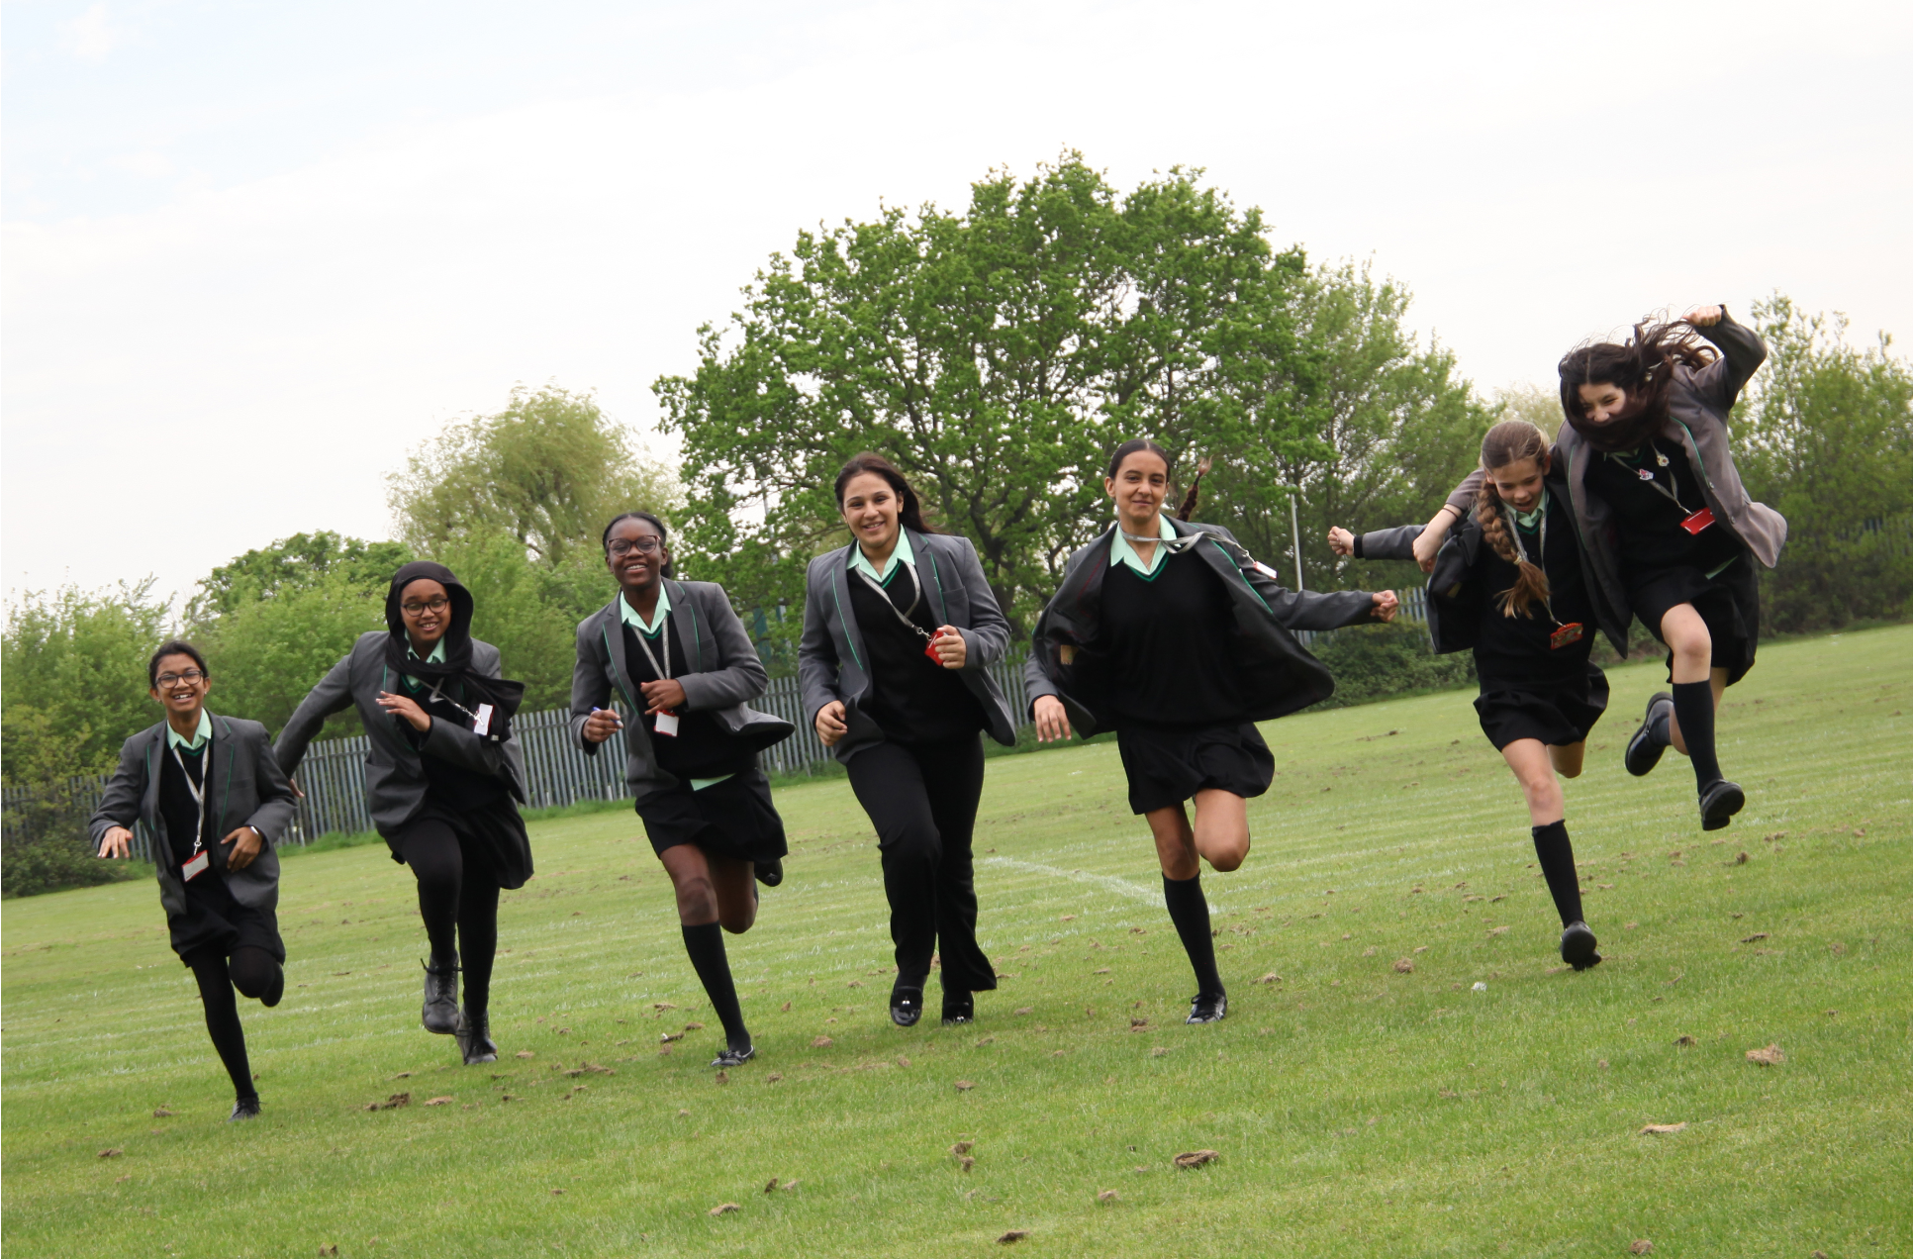
Introduction from Ms Stevenson

Slide 3
The purpose of this evening:
To welcome you into our school community
To introduce key members of staff
To give an overview of the year for your daughter
To answer any questions that you may have about school
To offer advice and guidance for the year ahead

Slide 4
Student
Success
Parents
School

Slide 5
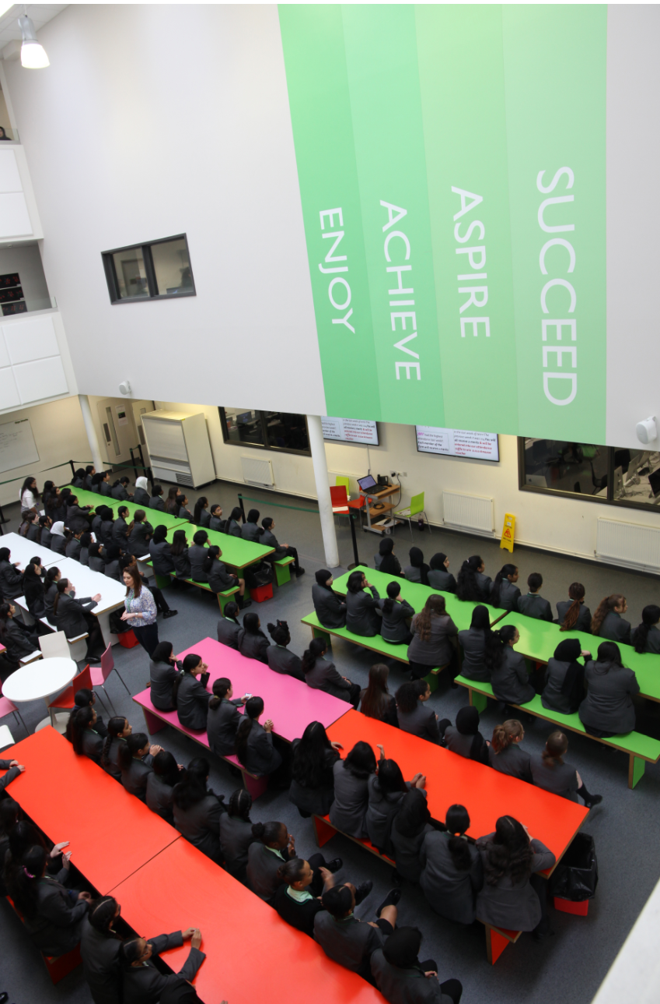

Slide 6
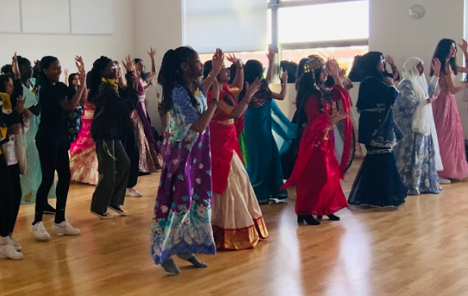
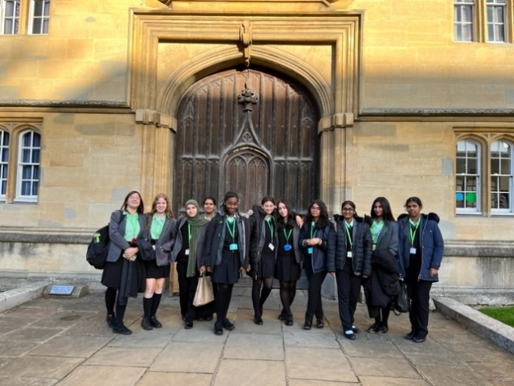
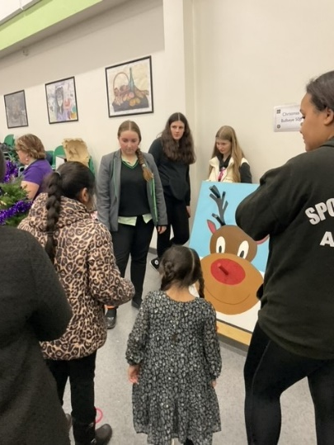
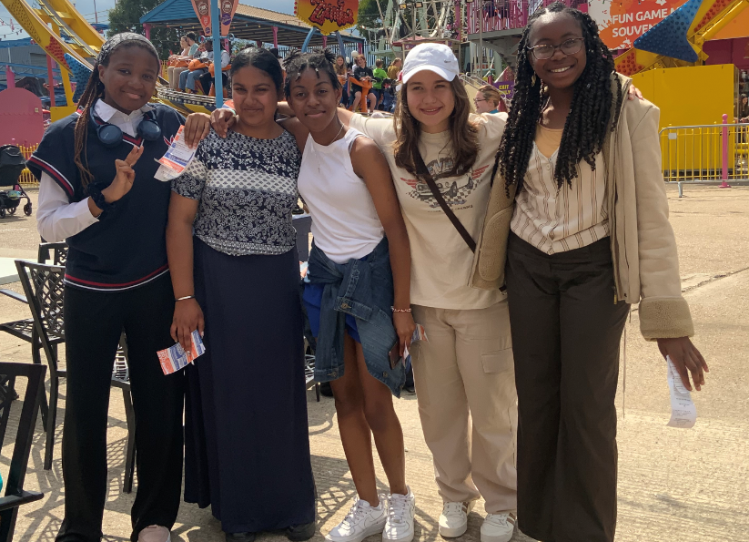
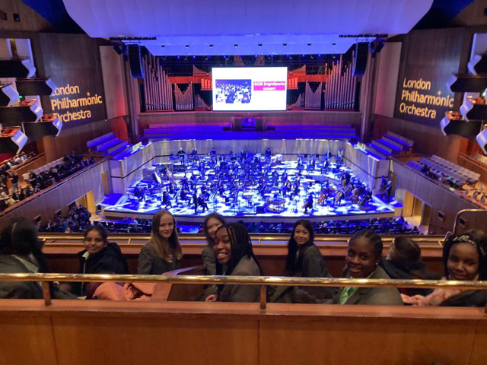
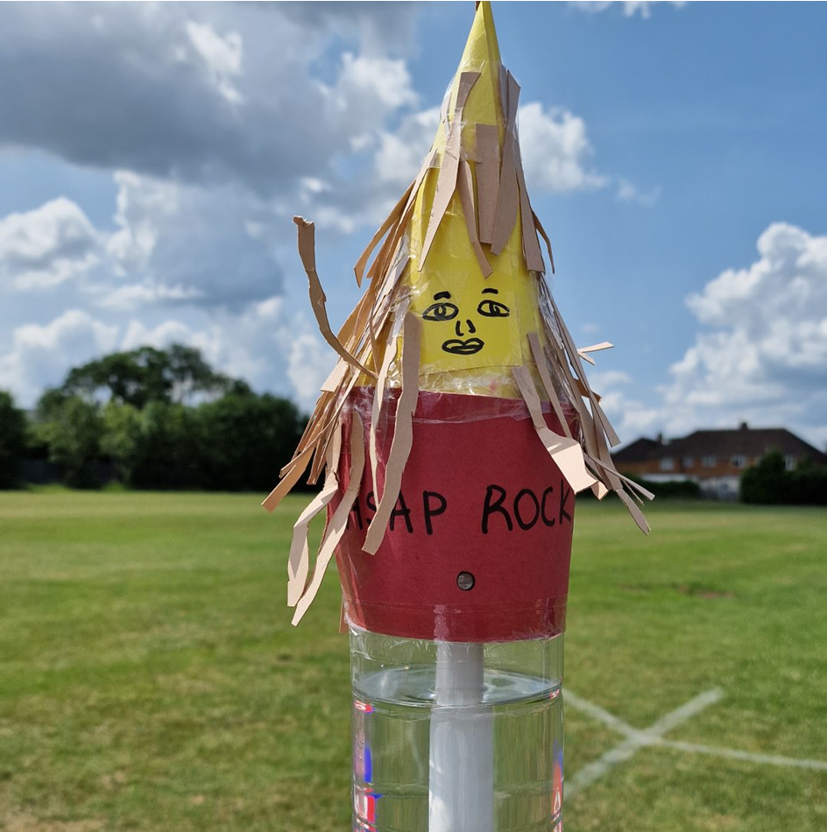
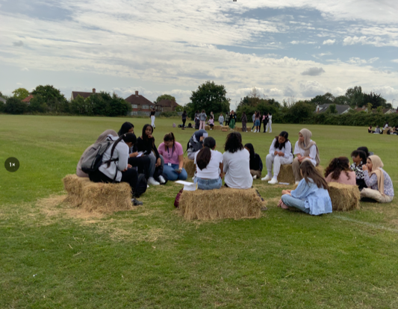
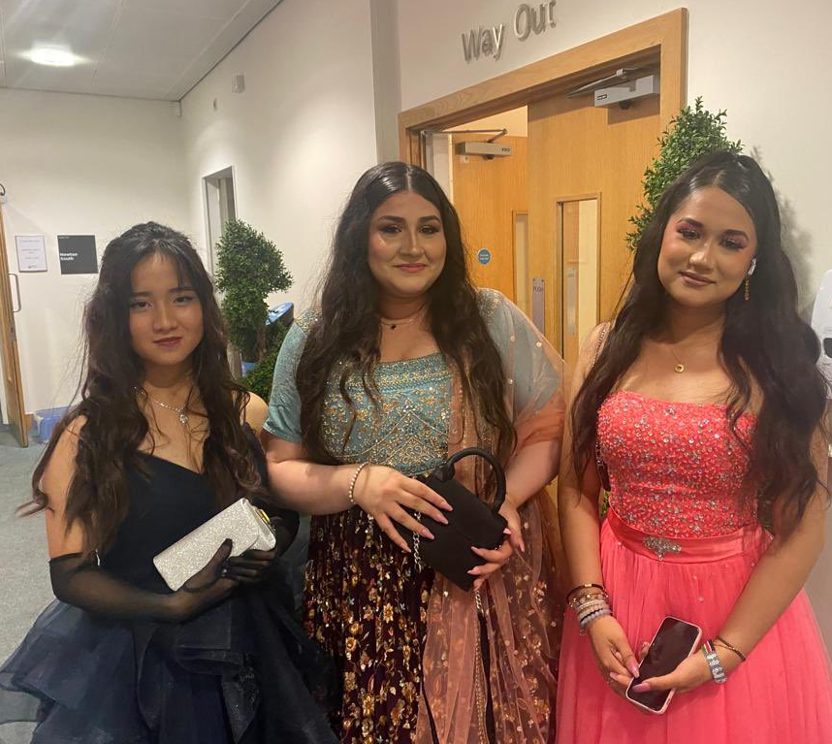
Enjoy

Slide 7
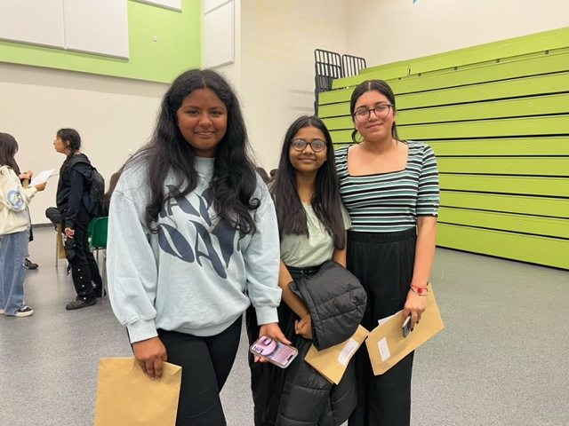
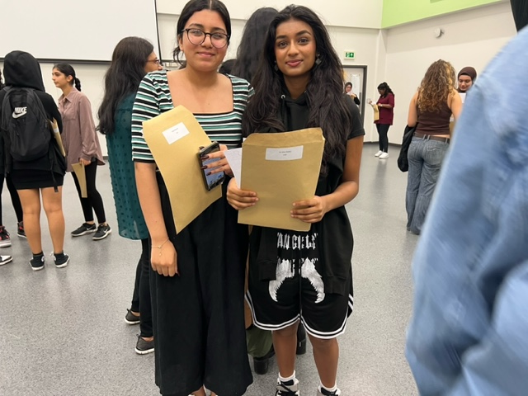
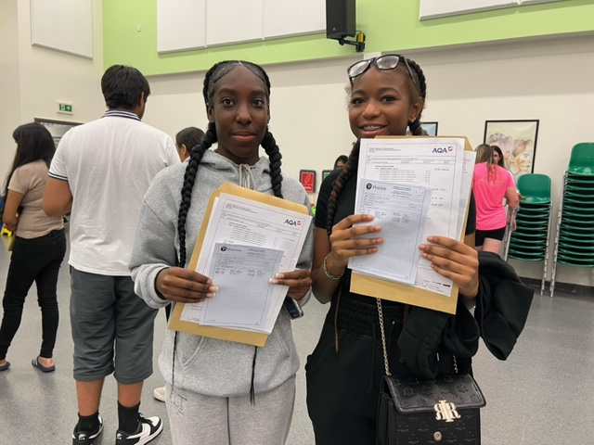
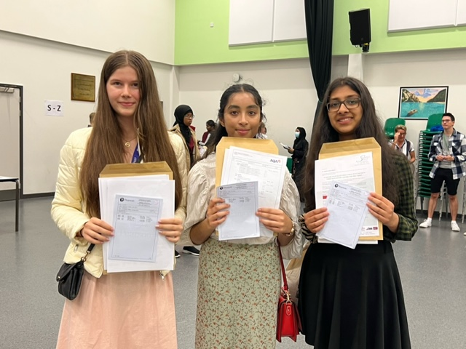
Achieve

Slide 8
Exam Success – GCSE
2023 headlines
80% achieved grade 4 and above with E&M
59% achieved grade 5 and above with E&M
500 grades 9-7
Notes:
There are two ways of looking at student data. The first is to look at the grades that students achieve. This is called attainment. And in our GCSEs this summer, despite the Government returning grade boundaries to 2019 levels, our students still did brilliantly with 80% achieving a standard pass in English and Maths and 59% achieving a good pass in English and Maths. 41% of all GCSE grades were the top grades of 7, 8 and 8. This is not correct, how about this – over half our pupils achieved one or more of the top grades, grades 9-7 with over 500 grades 9-7.
A reminder at this point that we are a fully comprehensive school taking students of all abilities – we do not select.

Slide 9
 | Swakeleys | Hillingdon
Attainment 8 | 53.2 | 46.0
9-5% EM | 59% | 51%
Ebacc APS | 4.67 | 4.09
Notes:
If we compare our attainment data to other Hillingdon schools you can see that we are significantly above on all of these measures. Attainment 8 is the average attainment across 8 best subjects and can be understood easily as the average grade Our average grade is a grade 5 and across Hillingdon schools it is a grade 4. APS is the average point score or average grade in the EBACC which is E, M, S, Hums and MFL

Slide 10
Exam Success – A level
2023 headlines
21% achieved A*/A
53% achieved A*-B
79% achieved A*-C
Notes:
At A level students achieved brilliantly with one fifth of grades being A*/A. Students worked incredibly hard and as a result were able to move on to follow their passion. Here are some destinations of our Year 13 leavers. I love seeing the variety of subjects and institutions that they have chosen and links to what I said earlier about being taught by subject specialists.

Slide 11
Year 13 successes and destinations
MA | A | A | A | City - Business with Finance
ZA | A* | A | A | LSE - Economics
LB | A* | A | A | Manchester - Geography
KB | A | A | A | Queen Mary - Economics
RD | A | A | A | LSE - Management
CF | A* | A | A | Royal Holloway - Psychology
BM | A* | A | A | Kings - PPE
SS | A | A | B + B | Bath - Chemical Engineering
KS | Dist | Dist | Dist | Brighton - Primary Education

Slide 12
Progress
Progress 8:
+0.61 in 2023
(unvalidated)
+0.93 in 2022
+0.84 in 2019
+1.04 in 2018
Notes:
The other way you can look at student data is to look at progress. In a school this would be looking at the point where students start in year 6 (the SATS are used) compared to what they achieve in Year 11.
The progress scores at Swakeleys are incredibly strong and have been for many years. I’ve not included the covid years when students didn’t sit exams as we know them.
This year despite the government returning grade boundaries to 2019 levels and taking away any advantages for the students, our students still achieved 2/3 of a grade better than expected across all 8 of their subjects. We expect this to be classed well above average when the progress data has been checked and validated by the Department for education.

Slide 13
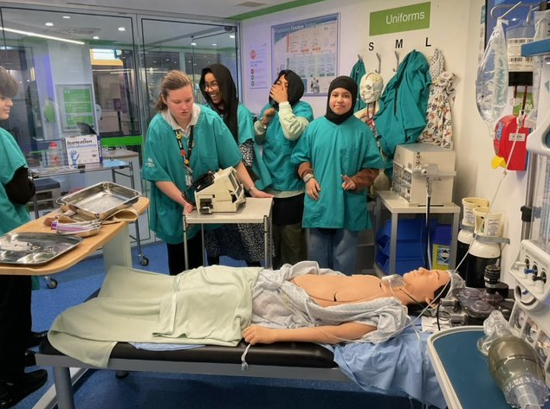
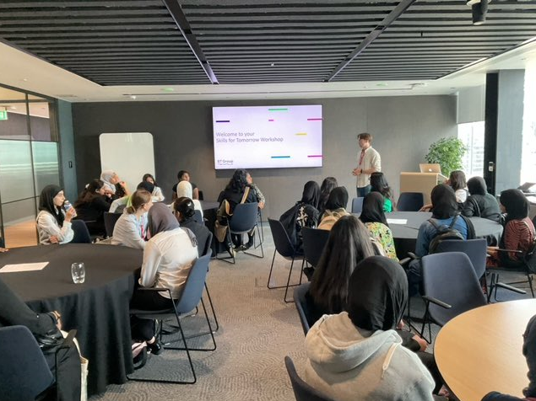
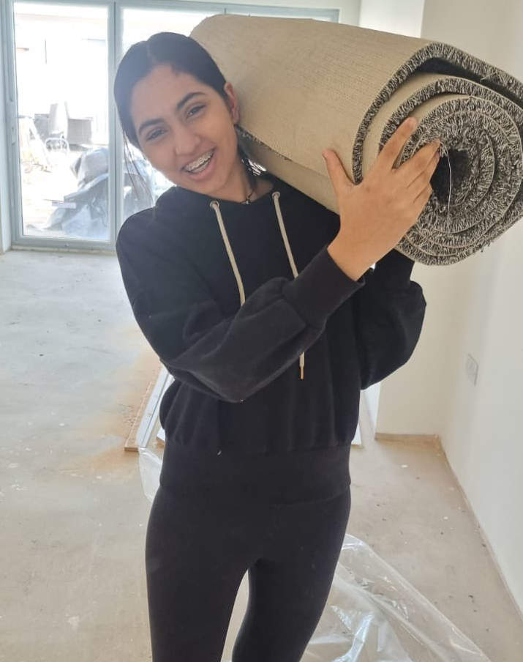
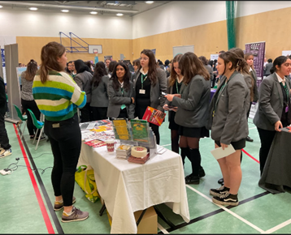
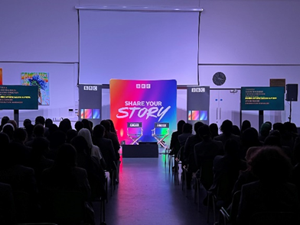
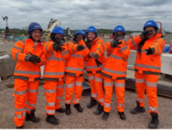
Aspire

Slide 14
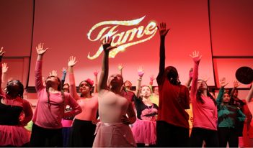
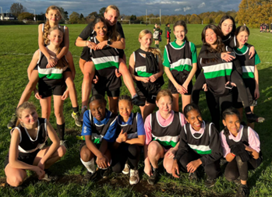
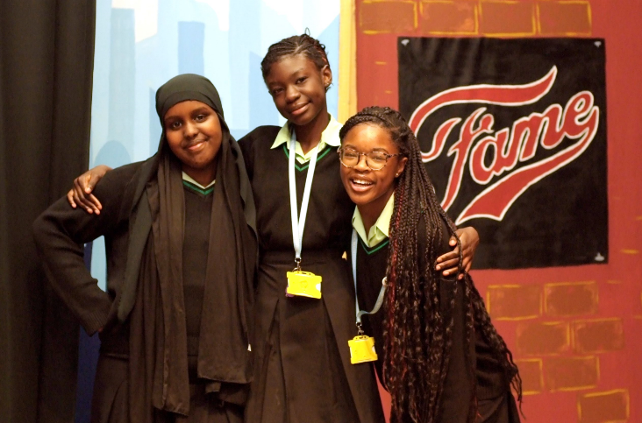
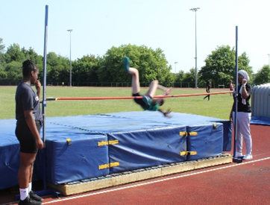
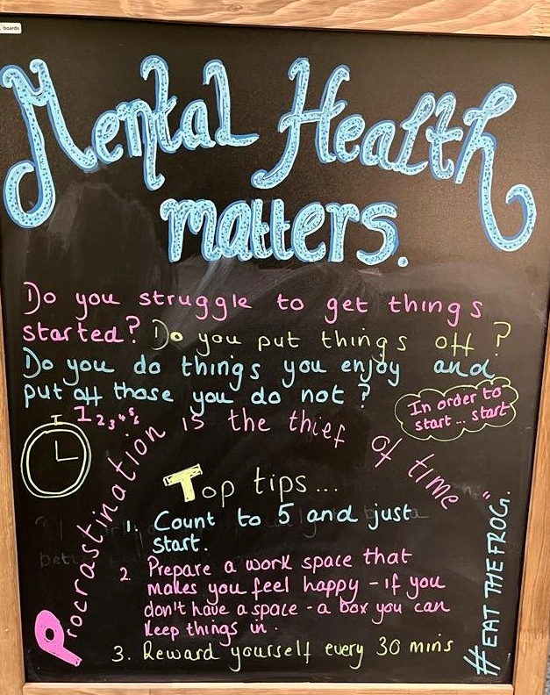
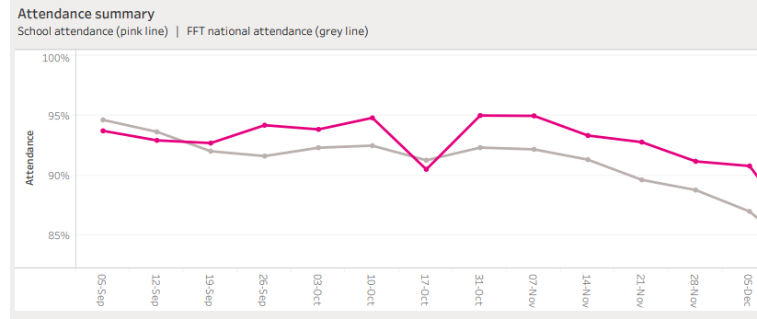
Succeed

Slide 15
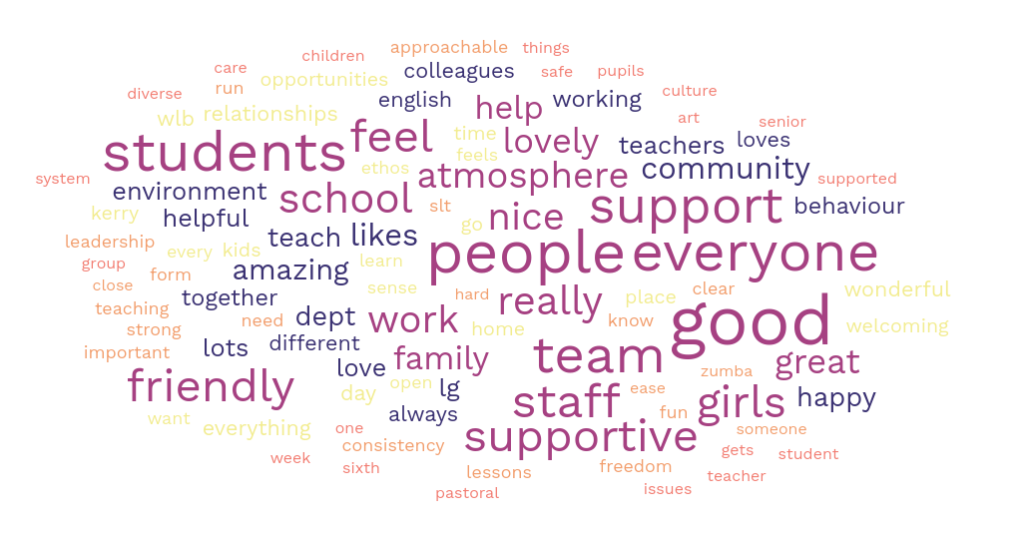

Slide 16
What you love about Swakeleys
“Safe and diverse, different cultures, inclusive, students voices are heard, make a difference, staff is one big family who support each other”
“There’s always something exciting happening. Great place to work. It's a challenge. Like working with young people and encouraging them to develop their confidence and working together”
“Support, clear structures re behaviour, colleagues. The girls are great. Ethos.”
“Pupils are amazing. It has been the joy of my life to be interacting with these students. Passionate and enthusiastic girls. Wonderful girls. Wonderful cohesive school. When it's going well it's symbiotic. I am happy to come into work every day”

Slide 17
What will we be focusing on this year?
Work shadowing – Year 10 & 12 Increasing attendance at clubs Reviewing homework – can we improve this? Helping students know how to revise A continued focus on debating Asking students how we can improve the outside spaces Asking students how we can improve the school Continuing to work with parents and take feedback from parents Increasing the security of the school Focus on attendance - & attendance awards Focusing on character and culture – what does it mean to each student to enjoy, achieve, aspire and succeed Introducing a new platform for online parents evening appointments

Slide 19
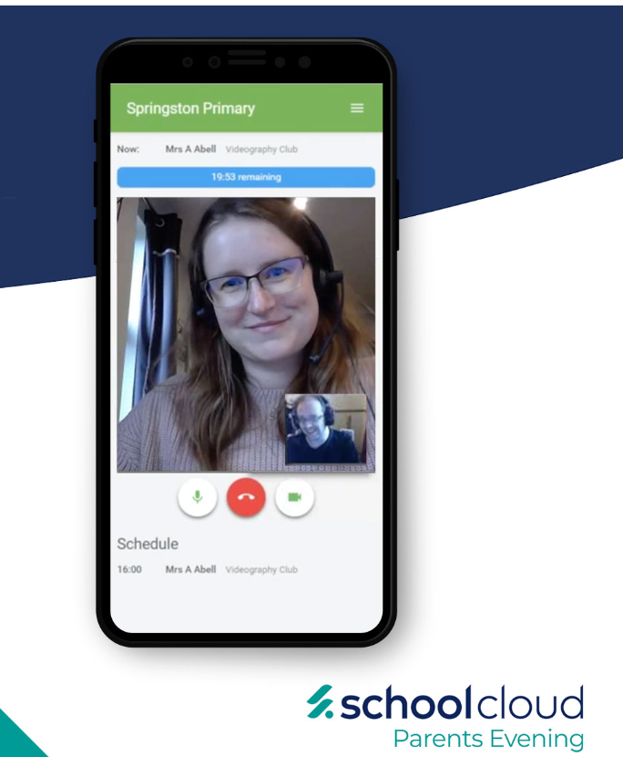

Slide 20
‘Your daughter is unique, there is no one like her in the whole world. She has a unique reason for being here, a purpose to discover and unfold in her life’ 10 things girls need most, Steve Biddulph

Slide 21
Year 7 Safe, Settled and Successful Evening
Miss H Allan
Year 7 Learning Co-ordinator

Slide 22
Year 7 Safe, Settled and Successful Evening
Enjoy

Slide 23
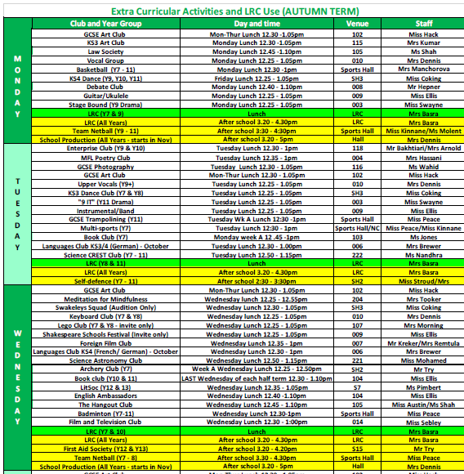

Slide 24
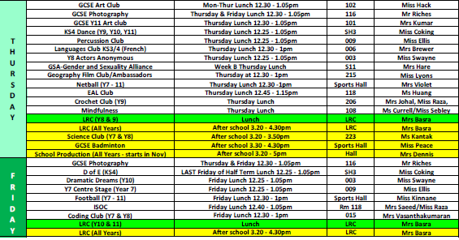
Year 7 are expected to join at least two extra-curricular clubs
Benefits:
Enjoy learning a new skill
Form new friendships and develop social skills
Develop further interests
Develop self-esteem and confidence

Slide 25
Year 7 Safe, Settled and Successful Evening
Achieve

Slide 26
Overall expectations
Your daughter will:
Attend all lessons
Be prepared for lessons
Complete homework as directed
Catch up with any missed work
How can your daughter make progress in English, Maths & Science both in school and at home?

Slide 27
English and Literacy

Slide 28
English and Literacy
How to help your daughter
At Secondary School English is a defined subject, separate from literacy.
Literacy now goes across all subjects, and all subject teachers will help your daughter with her literacy skills.

Slide 29
Why reading matters
Reading and learning is more important than anything else in helping her to fulfil her potential.
Books contain new words that will help build your daughter’s language and understanding.
Readers are more confident and have greater job opportunities.
It expands imagination and knowledge.
Please encourage your daughter to join the Year 7 Reading Room on Google Classrooms – her English teacher will give her the code.
Reading Lists will be emailed home in the next week or so – well-researched and diverse texts that will enrich and extend her reading.
It is fun!
Pupils should be reading for at least 20 minutes per day in their own time.

Slide 30
What we will do as a
school to help
School Library
Reading Lists
Private reading in classes
Choosing texts to read that are engaging
Paired Reading
Booster Classes
Accelerated Reader
Book Clubs
Speed reading sessions
Literature festival in the summer
Google Classroom ‘Reading ReBoot Room’

Slide 31
What you can do to help: Make time for reading!
Talk about what she reads and share good books.
teenreads.com provides reviews of books for teenagers by teenagers.
Use your local library.
Select more challenging books for gifted/avid readers. Your daughter has a reading list with these indicated.
Suggest older children read with younger members of the family.
Read yourself!
Encourage time for reading

Slide 32
What you can do to help: Make English fun!
Make time to talk
Play classic games like ‘Scrabble’, Pictionary or faster ones like ‘Double Quick’.
Try puzzle books for odd free moments.
Listen to the radio or to audio books or even podcasts.
Visit museums and castles; use the audio guides.
Investigate word games APPS to play on phones
Encourage your daughter to love words and be a collector of words.
Investigate the website JetPunk for English related quizzes.

Slide 35
What if we don’t have internet access at home?
Students can use computers in the
library.
Year 7 library lunch times to use the library are: Monday & Wednesday.
If internet access is an issue do please make Miss Allan aware of this – there is a form here to put your daughter’s name on if internet access or access to a device is an issue.

Slide 36
Key Stage 3 Science
Year 7:
“Being a scientist: lighting fires lessons”
Activate 1 scheme of work
Modules of Biology, Chemistry and Physics
End of unit tests
How you can support?
Seneca learning
Kerboodle
CGP study guide
Homework can be found on ePraise
Google classroom
Year 8:
Activate 2 scheme of work
Modules of Biology, Chemistry and Physics
End of unit tests

Slide 37
Year 7 Revision spreadsheet for Science
Independent revision spreadsheet available:
https://docs.google.com/spreadsheets/d/e/2PACX-1vSAj7ifY5bqOWjXYOtcqnq4Skg_Irnu3P144eMq4ABjHj7ITH2TsBcl1zt2qMOXwbUVhUQZA4OCFSz_/pubhtml
Parents can mark child’s work using mark schemes attached on the spreadsheet too
Science teachers will demonstrate how to use spreadsheet to pupils in lessons

Slide 39
Careers Guidance at Swakeleys
A Year 7 Careers google classroom page.
The classroom code is lpcuufk which advertises opportunities – turn ON notifications!
Encourage ALL students to make use of our independent careers advisor based in school Tuesday - Thursday. Appointments are currently being prioritised for our Year 11 pupils
Regular careers newsletters which are shared via google classroom and emailed out
Unifrog – one stop careers guidance platform
All pupils will be sent a welcome email inviting them to use the Unifrog webite.
Notes:
Slide 1- these are some of the things that we currently have in place for Year 7 students:
Talk through bullet points.
Unifrog is our one stop careers guidance platform which we have been using since January with all pupils.
We are now inviting YOU as parents / carers to login to the platform and explore the careers platform with your child.

Slide 40
The Unifrog tools
Exploring pathways
Recording what you’ve done
Searching for opportunities
Drafting application materials
Making applications
Careers library
Activities
UK universities
UK Personal Statement
Post 18 Intentions
Subjects library
Competencies
US universities
Classes
Locker
Know-how library
Interactions
European universities
Subject References
Applications list
MOOC
Oxbridge
CV / Resumé
Personality profile
Canadian universities
Writing tool
Interests profile
Asian universities
Common App Essay
Read, Watch, Listen
Australasian universities
US recommenders
Webinars
ME and African universities
Notes for Reference writers
Irish universities
Special Opportunities
Events
Notes:
Once you / your child log into the platform, you will be presented with a whole range of options.
Explore career pathways
Keep a record of competencies and skills being developed
Search for Universities / 6th form colleges
Draft

Slide 41
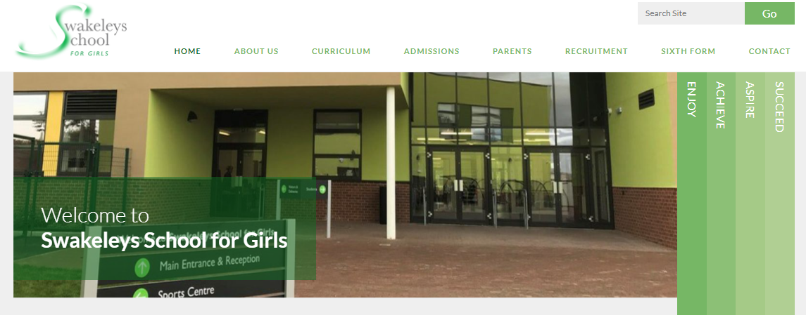
The Curriculum
If you wish to find out more about each subject please go to our website and click on the ‘Curriculum’ tab.

Slide 42
Year 7 Safe, Settled and Successful Evening
Aspire

Slide 43
Assessment across Key Stage 3
Four Stages of Learning:
Mastery
Secure
Developing
Foundation
Many pupils will start out at the foundation stage of learning – please do not worry!

Slide 44
What do the Stages of Learning mean?
Mastery (High level learner)
Reached the Key Stage 3 requirements of the subject in many, if not all of the Progress Areas
Can extend and apply ideas and has a high level of subject thinking and reasoning
Secure (proficient leaner)
Good all-round basis in the subject
Link and relate ideas and concepts, strategies for thinking and reasoning
Developing (more competent learner)
Grasped many of the basic ideas and concepts of the subject
Link different skills and concepts together
Foundation (beginning learner)
Starting to grasp some of the basic content of the subject
Can recall and reproduce basic content and single ideas

Slide 45
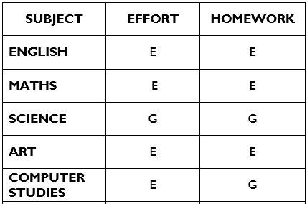
What will a report look like?
Effort and homework:
E: Excellent
G: Good
S: Satisfactory
B/A: Below average
October’s report will look like this as only effort & homework are assessed.

Slide 46
Year 7 Safe, Settled and Successful Evening
Succeed

Slide 47
Organisation: How you help?
Being organised in the morning will mean your daughter will have a calm start
What can you do?
Ensure her bag is packed the night before
Check her epraise account to make sure homework is completed
Ensure her lanyard is in her school bag or blazer
Have her uniform ready and all in one place
Getting up in good time to have breakfast and leaving for school on time

Slide 48
epraise.co.uk
Login Details:
Your daughter has received a sticker with her login details and this should be in her link book

Slide 49
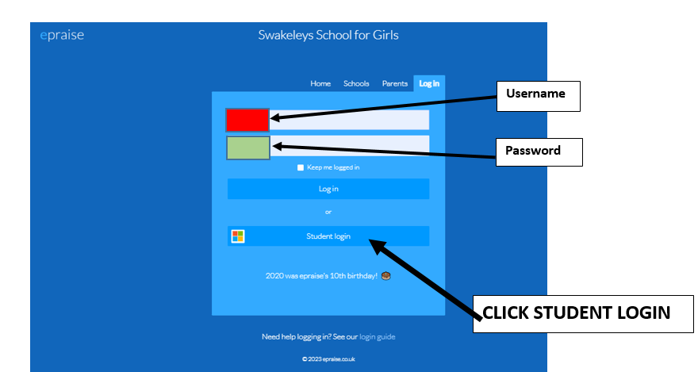
epraise.co.uk

Slide 50
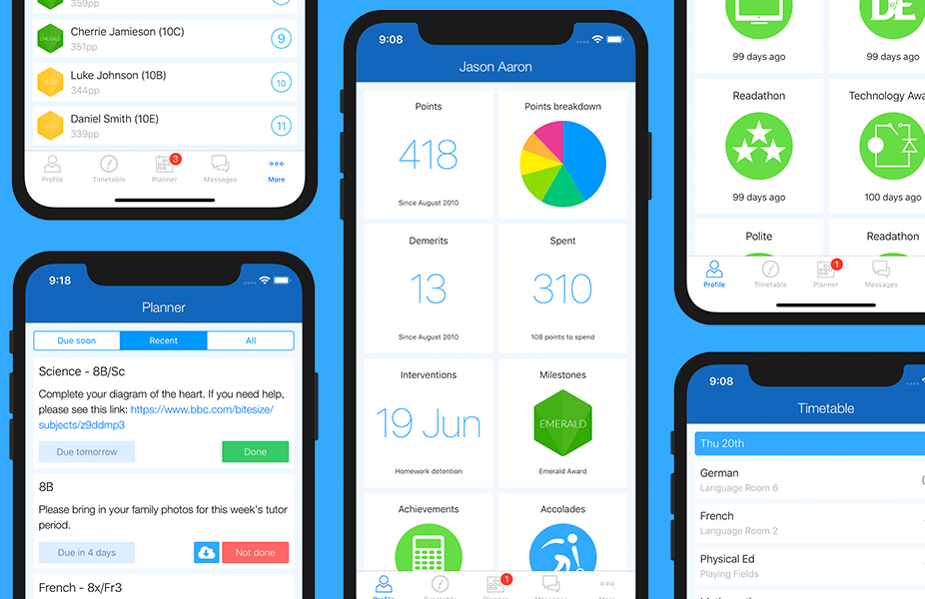
epraise.co.uk
Parents, you can download the epraise app to your phone using your daughter’s login details.

Slide 51
Google Classroom
Login Details:
Your daughter uses her Google Classroom login to access GC

Slide 52
Google Classroom
Your daughter should have joined a GC for every subject and Year 7 Pastoral Miss Allan
Here lesson resources/information/updates will be given
Students can also comment for example on an assignment if they need help and the teacher will reply as soon as possible

Slide 53
Attendance
Aim for 96-100% attendance
If you don’t feel you want to come in-try! You will probably feel better and if not welfare will send you home.
Attendance is closely linked to attainment-which is why schools think it is so important.
We have a reward system for excellent attendance which your daughter can be included in for attendance that is 96-100%.
Please do not book holidays in term time-they will not be authorised.
Notes:
Go through the slide

Slide 54
Extensive research has shown the impact that attendance can have on the grades that pupils achieve at the end of Year 11.
A pupil with attendance below 95% has significantly less chance of securing 5 or more good passes at GCSE.
Notes:
Go through the slide

Slide 55
Punctuality
At Swakeleys we have a zero tolerance policy for lateness. This is the reason:
If you are 5 minutes late each day you lose the equivalent of 3 days learning a year.
If you are 15 minutes late a day you lose 9 days learning a year.
Punctuality is an important life skill that is valued by schools and sixth forms. References always ask about punctuality.
Notes:
Go through the slide

Slide 56
Safeguarding and Staying Safe

Slide 57
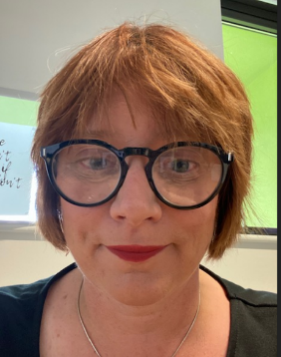
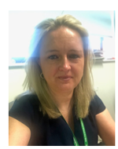
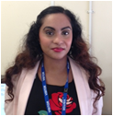
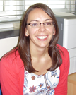
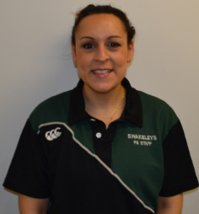
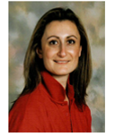
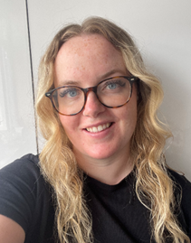
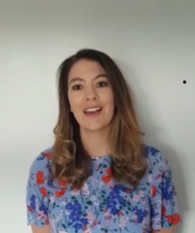
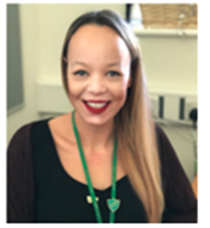
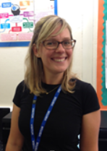
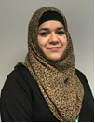
If you have any concerns or questions about the safeguarding of any young person while you are at Swakeleys School For Girls please speak immediately to the Designated Safeguarding Lead or a Deputy.
Hillingdon MASH
strongerfamilieshub@hillingdon.co.uk
01895 556006
The Designated Safeguarding Leads are:
Mrs G Hare
Deputy Head/Lead DSL
Miss S Hanlon
Assistant Head/Deputy Lead DDSL
Ms M Shah
Assistant YLC/
KS3 English
Mrs J Cherry
Lead
Practitioner/
6th Pastoral Lead
Mrs L Finnerty
YLC
Ms S Mejloumian
YLC
Ms K Currell
YLC
Miss H Allan
YLC
Miss F Swayne
YLC
Mrs F Sheldon
YLC Assistant
Mrs C Dennis
CL Music/
6th Pastoral Lead
Mrs A Hussain
YLC Assistant

Slide 58
Managing Online Behaviour
Typical sources of worry and
arguments
The amount of screen time
Available content
Cyberbullying and social issues
Grooming
The online world isn’t going anywhere!
It is very important to develop open dialogue with you child and make checking a regular part of the family routine.
What apps do you have downloaded?
Let’s check our screen time?
What content do you look at regularly?
Has anything that has happened online recently made you feel uncomfortable?
Useful links for parents:
https://www.thinkuknow.co.uk/parents/
https://www.internetmatters.org/
https://swakeleys.hillingdon.sch.uk/safeguarding/
Notes:
Typically online behaviour can be at the root of many family disputes in the teen years. Some typical issues are
The amount of screen time-studies have shown that anything above 4 hours a day can be damaging. Screen time can be addictive due to the dopamine hit that teens get when they access online content, and can impact on brain development. The light from screens can affect sleep. We recommend switching off 30 minutes before bed.
We recommend ensuring that you have filtering and monitoring set up so you can limit content that your child can access. You phone and network provider should be able to advise what is possible.
Because of the nature of screen chat, teens can be drawn into cliquey behaviour or even cyberbullying. If they are a victim or feel excluded they can experience this for all the hours that they have their phone available.
Grooming-any site that has a chat facility leaves your child susceptible to online chat. This includes roblox and other gaming sites. Please also remember that Whatsapp. Messaging and e mail can be used for this purpose.
Make life easier by regularly talking about online activity, and try and foster a relationship ith your child where they can tell you about things that are worrying them online. Questions line:
What apps do you have downloaded?
Let’s check our screen time?
What content do you look at regularly?
Has anything that has happened online recently made you feel uncomfortable?

Slide 59
Mental Health services available
Place2Be and Place2Talk
Place2Be provides emotional and therapeutic services in primary and secondary schools, building young people's resilience through talking, creative work and play.
Place2Talk is here at break or lunchtime to support young people to think about any worries they might have.
How: Email place2be@swakeleys.org.uk
What: Book a 15 minute appointment
When: Break or lunchtime (Monday to Thursday)
For: Individual or small group session (up to 3 people)
Confidential unless there is a safeguarding concern

Slide 60
Mental Health services available
We also have a Pastoral Support Team.
Mr Tottman & Ms Ferreira are available to be seen at break time and they will see students on a weekly basis by appointment if it is felt that support is required.
shout : text support service
24/7 crisis text line
Text P2B to 85258
www.giveusashout.org

Slide 61
Form tutors
7FN | Ms A Samuels
7MC | Mrs R Kantak
7EB | Ms L Jones
7JA | Miss H Sebley
7AF | Mrs L Hayes
7RP | Ms C Braban (Assistant YLC7)
7MY | Mrs M Vasanthakumar
7DS | Miss R Sood

Slide 62
Key Dates for Year 7 Autumn Term
Thursday 5th October: School Photographs.
Wednesday 11th October: INSET Day & Year 7 EH reports emailed to parents
Monday 16th October: Year 7 Senator Nominees
Friday 20th October: Form Tutor We Listen Day Year 7
Half Term: Monday 23rd October – Tuesday 31st October
Friday 17th November: Year 7 Senator Elections.
Thursday 23rd & Friday 24th November: INSET Days
Wednesday13th December: Year 7 Pantomime
Wednesday 20th December: Christmas holidays, return to school Monday 8th January

Slide 63
Thank you
Please use the QR code to now complete the short questionnaire regarding your daughter’s start to secondary school:
Scan me

