Slide 1
PiXL Gateway - Masterclass 3
German
Adding sophistication to your writing and speaking

Slide 2
Adding sophistication to your writing and speaking
Grammar
Skills
Adding detail
Paraphrasing
Recycling
Essay writing

Slide 3
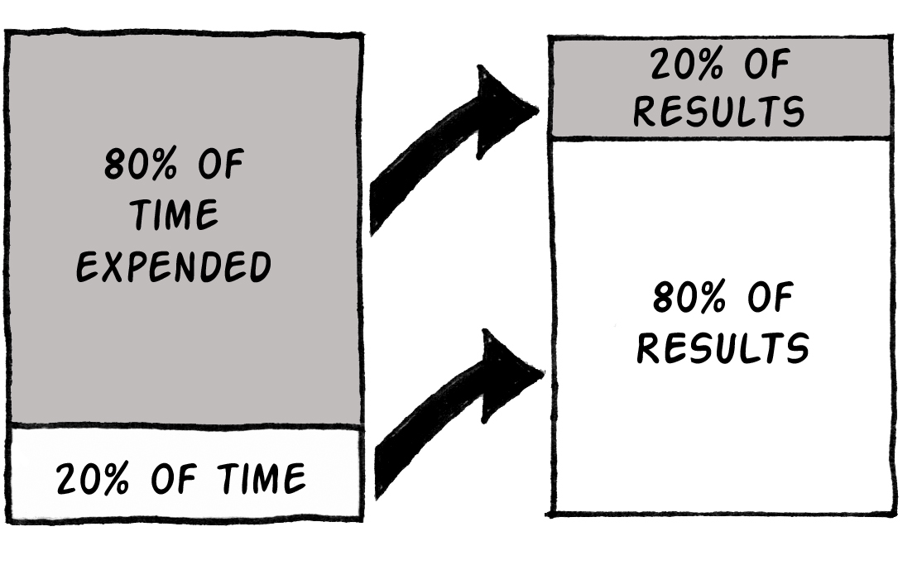
Adding sophistication to your writing and speaking: Grammar
The 80 - 20 Rule
Notes:
The 80–20 rule states that, for many events, roughly 80% of the effects come from 20% of the causes. By extension, 80% of your outcomes come from 20% of your inputs.
At A level, we can’t tackle the entire complexity of language, but we can concentrate on a small but useful percentage of it that will enable us to produce a great amount of language and will also make us feel like we can manipulate language creatively.
We must make sure we
Master that 20% of grammar.
Remember to include it in all of our speaking and writing.
Using a grammar checklist in our initial stages may prove helpful. There is an example of a grammar checklist in the following slide.

Slide 4
Adding sophistication to your writing and speaking: Grammar
German grammar checklist
Stick it on the front of your file.
Make sure that you know what each of these terms mean – if not, revise them!
Try to tick all the boxes every time you write an essay or prepare for a speaking exercise.
Include a range of each grammar item in your speaking and writing.

Slide 5
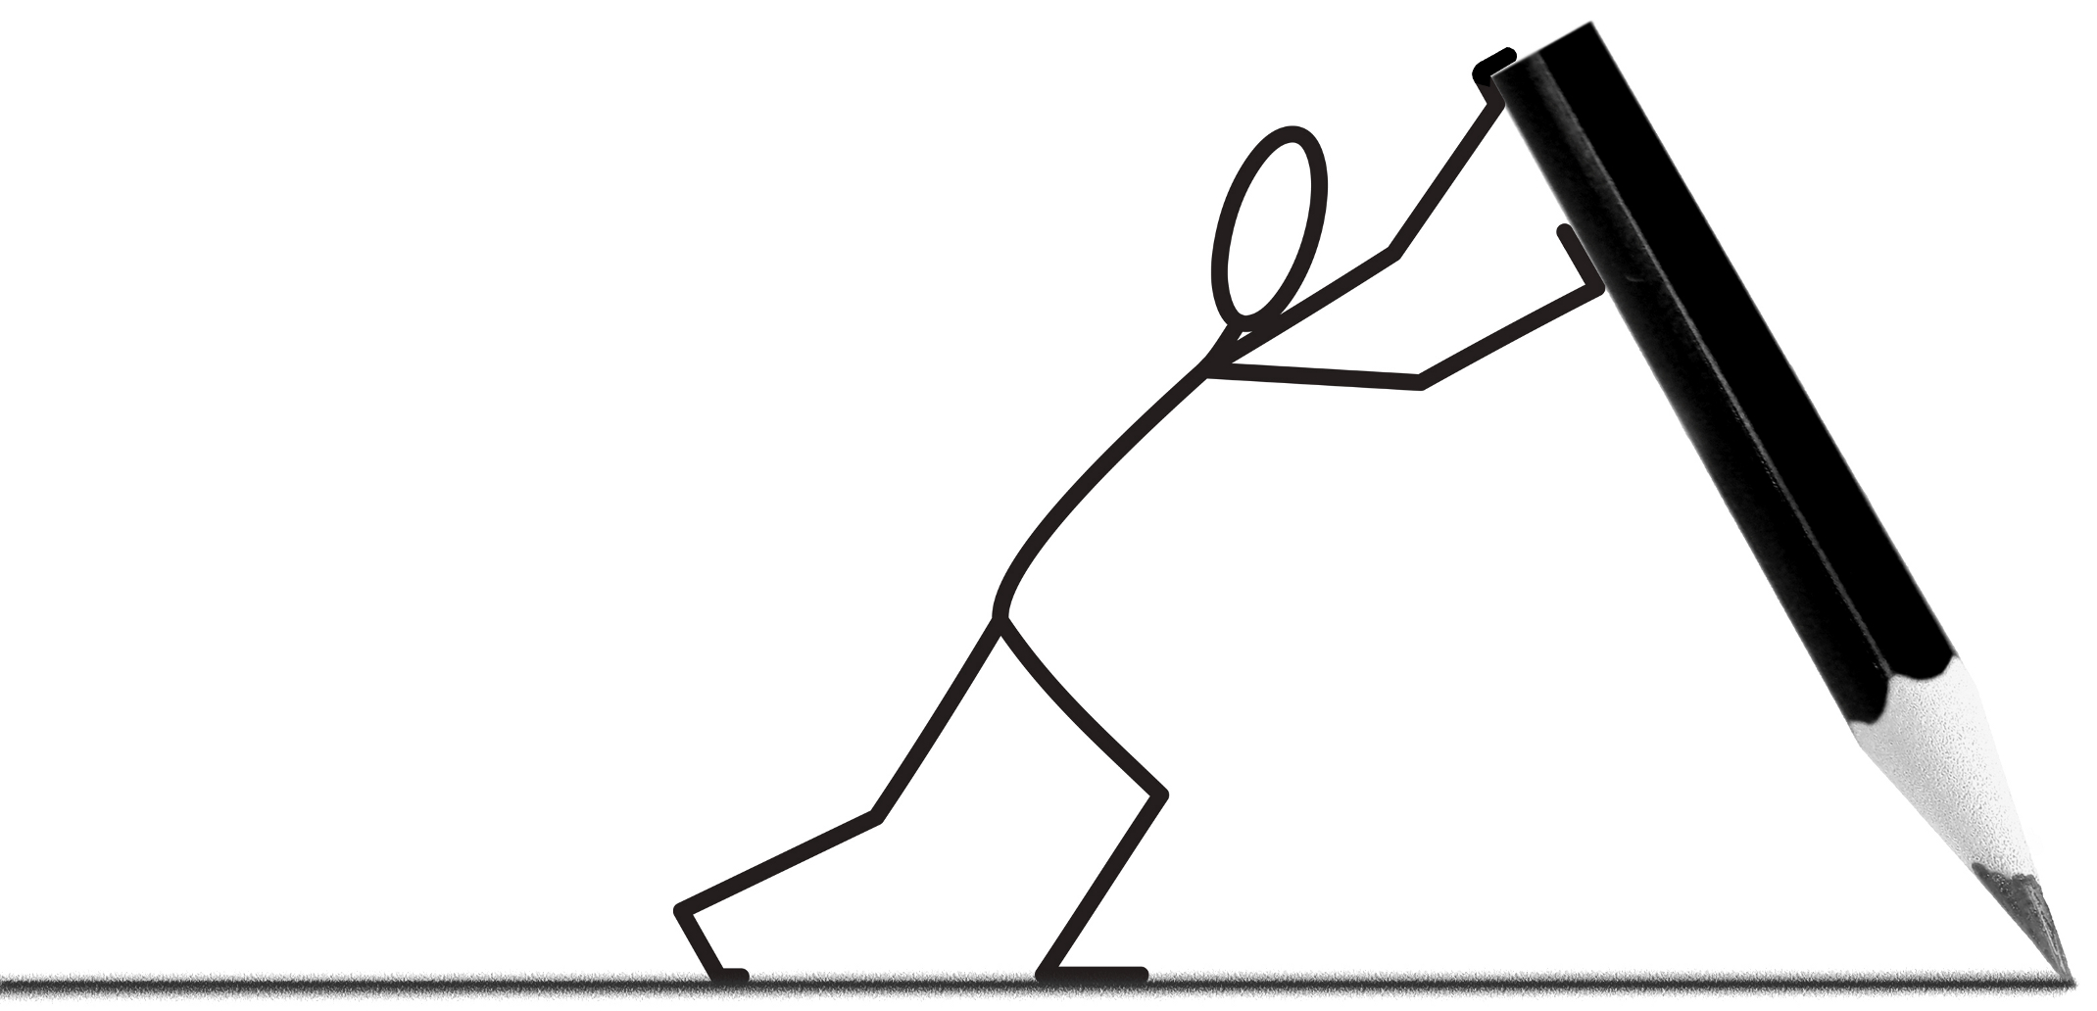
Adding sophistication to your writing and speaking: Key skills
Adding detail
Paraphrasing
Recycling
Notes:
Students can’t rely on their memory alone when it comes to speaking and writing at A Level.
Instead, they will have to develop a set of skills and accumulate a base of knowledge.

Slide 6
Adding sophistication to your writing and speaking: Adding detail
An adjective for every noun
What it looks like
Proof
What, who, when, where, why?
Examples
Impact
Similar situations
Topic
Opinion: my own and that of others
Morally right?
The past
How it feels
Both sides of the story
Evolution
Hypothesis
An adverb for every verb
Relationships
What it is not – negatives
Notes:
These are a many ways in which you can add detail.
Negatives are crucial, as they can potentially double the amount of language that we can produce.
The higher grades will only be accessed though hypothesising and higher level thinking.
Go through these and discuss what these would look like in a presentation or essay.

Slide 7
Adding sophistication to your writing and speaking: Adding detail
Österreichern sind ihre Traditionen sehr wichtig. Traditionen Österreich sind nach Regionen verschieden. Viele alte Traditionen haben einen engen Zusammenhang mit kirchlichen Festen. Das Jahr beginnt mit Fasching, mit vielen Bällen, in manchen Gegenden auch mit Umzügen, allerdings anders als in Deutschland.
Besonders in ländlichen Gebieten im Westen von Österreich sind diese Traditionen lebendig und oft Attraktionen für den Fremdenverkehr. Die Fastenzeit beginnt mit einem Heringschmaus am Aschermittwoch. Die Fastenzeit selbst wird auf ganz unterschiedliche Art eingehalten. Die einen rauchen nicht, die anderen naschen nicht, auf Alkohol wird verzichtet oder auch auf Fernsehen oder aufs Autofahren.
Die Weihnachtsmärkte sind hierzulande sehr beliebt. Sie entstanden in etwa im 13. Jahrhundert, als der Brauch aufkam, einander zu Weihnachten zu beschenken.
https://www.expedia.de/vc/reisefuehrer/traditionen-oesterreich-r6835
1. Die einen rauchen nicht, die anderen naschen nicht, auf Alkohol wird verzichtet oder auch auf fernsehen oder aufs Autofahren.
2. Sie entstanden in etwa im 13. Jahrhundert, als der Brauch aufkam, einander zu Weihnachten zu beschenken.
3. Viele alte Traditionen haben einen engen Zusammenhang mit kirchlichen Festen.
4. Österreichern sind ihre Traditionen sehr wichtig.
An adjective for every noun
What it is not – negatives
Hypothesis
The past
Extension – add further details to the text
The past
Notes:
These are 4 examples of ways in which we could add detail to a text. It’s important to get in the habit of adding detail every time we speak or write so that it becomes automatic for us to do so.
Quickly read the text and match the sentences to the ways in which detail has been added.
Then, complete extension exercise. Try to use other ways when completing it.

Slide 8
Adding sophistication to your writing and speaking: Paraphrasing
Use like (wie, es scheint, es ist genau wie…)
Use synonyms
Use antonyms (es ist nicht, das ist das Gegenteil von …)
Explain use, appearance, qualities, location…
Es ist das Gleiche wie aufpassen
unerlaubte vervielfältigung
Es ist ein Geheimcode
In Person
vorsichtig sein
das Password
die Piraterie
persönlich
Match up
Practise paraphrasing these four words:
ein Handy
ein Computer
eine Familie
die Liebe
Notes:
There are many occasions when we need a word but we can’t remember it. The skill of paraphrasing is crucial at these times. These are 4 ways in which we can paraphrase.
Complete matching exercise in order to see some examples of how words have been paraphrased and use these examples to paraphrase the words in the second exercise.

Slide 9
Adding sophistication to your writing and speaking: Recycling
❶Recycling is manipulating sentences that you have stored in your memory.
❷The key to good recycling is to replace like for like.
❸Beware of idioms – their parts can’t be replaced.
Ich würde es gern, wenn mein Bruder weniger spricht.
Ich würde es gern, wenn mein Bruder weniger trinkt.
Ich würde es gern, wenn mein Bruder weniger ausgeht.
Ich würde es gern, wenn mein Bruder weniger spricht.
Ich würde es gern, wenn meine Mutter weniger spricht.
Ich würde es gern, wenn meine Frau weniger spricht.
Ich würde es gern, wenn mein Bruder mehr spricht.
Ich möchte es gern, wenn mein Bruder mehr spricht.
Ich möchte es nicht gern, wenn mein Bruder mehr spricht.
Discuss how the sentences have been changed?
Notes:
Recycling is using sentences that you know and, more importantly, that you know are correct, in new situations.
It is important to know how to recycle, so that the language we produce remains correct.
Here is an example of a sentence that has been recycled. Ask students to reflect on how the changes have happened.

Slide 10
Adding sophistication to your writing and speaking: Recycling
Read the following phrase:
Wenn der Regisseur diese Technik nicht verwendet hätte, hätte er nicht das Thema so stark verdeutlicht.
Wenn | der Regisseur | diese Technik | nicht | Verwendet hättehätte, | würde er | nicht | das Thema | so stark | verdeutlicht.
Use the phrase above to help you to form the following phrases.
If the director hadn’t understood the premise of the story, he wouldn’t have been able to describe the situation in such a clear way.
If the audience hadn’t seen this scene, they wouldn’t have been able to empathise with the character in such an intimate way.
If the character hadn’t experienced this trauma, he wouldn’t have been capable to evolve in such a dramatic way.
! The key to good recycling is to replace like for like.
Notes:
Recycling is a more valuable skill when we use it with sentences that are so complex that we would be unlikely to produce them from scratch.
In order to recycle a sentence, it is important to know how to break it down into its grammatical components first and then, replace components (one or more) observing the principle of ‘like for like’, i.e. replace a word for another one that is grammatically the same.
Use my broken down sentence to translate the sentences below.

Slide 11
Essay writing: Planning
Introduction
Your thesis or idea that you are about to put forward.
Main ideas
The reasons why your thesis is correct.
Supporting details
Factual proof that your main idea is correct (statistics, quotations, historical facts, scenes from a film).
Conclusion
Summary and stating that you have proved your thesis.
Notes:
Go through the different parts of an essay.
Credit for the picture: http://www.readwritethink.org/files/resources/interactives/essaymap/
This is an excellent website for students to plan their essays.

Slide 12
Essay writing: Writing stages
Machen Sie einen Aufsatzplan:
Aus welchen Gründen hatte das Werk / den Film viel Erfolg? Finden Sie persönlich die Geschichte überzeugend?
Read and understand the title.
Draw/print a blank essay map.
Brainstorm ideas - all ideas at this stage are good.
Re-read your ideas and select the ones that will make for an interesting, coherent essay.
Decide on your thesis.
Place your ideas in your essay map.
Think of three supporting details for each of your main ideas.
On a separate sheet, write a list of key phrases that you want to put in your essay (high level grammar, idioms, discourse markers…).
Start writing your essay, with both sheets in front of you. Make room for all your key phrases.
Check over your essay.
35 minutes
20 minutes
5 minutes
Notes:
Go through the essay writing process and reflect on the amount of time that is required for the planning stage vs the writing stage.
Emphasise that all stages are necessary and that without the planning stage, an essay will not achieve the higher grades.

Slide 13
© The PiXL Club Ltd. September 2018
This resource is strictly for the use of member schools for as long as they remain members of The PiXL Club. It may not be copied, sold, or transferred to a third party or used by the school after membership ceases. Until such time it may be freely used within the member school.
All opinions and contributions are those of the authors. The contents of this resource are not connected with, or endorsed by, any other company, organisation or institution. These papers were made by teachers in good faith based upon our understanding to date.
PiXL Club Ltd endeavour to trace and contact copyright owners. If there are any inadvertent omissions or errors in the acknowledgements or usage, this is unintended and PiXL will remedy these on written notification.

